Slide 1

History of the Brunswick Volunteer Fire Company
Pictures and stories of the Fire Company from the time of organizing to present. The more than 10 years of research by Jim Dixon Past President.

Slide 2
We hope you take the time to enjoy this slide presentation from a 100% Volunteer Fire Station serving you for over 100 years.
Thank you
For your support

Slide 3
1890
Fire protection for the Town of Brunswick gets its first mention. Several water companies are formed in the community, one of which has, as one of its stated purposed, also for fire protection.

Slide 5
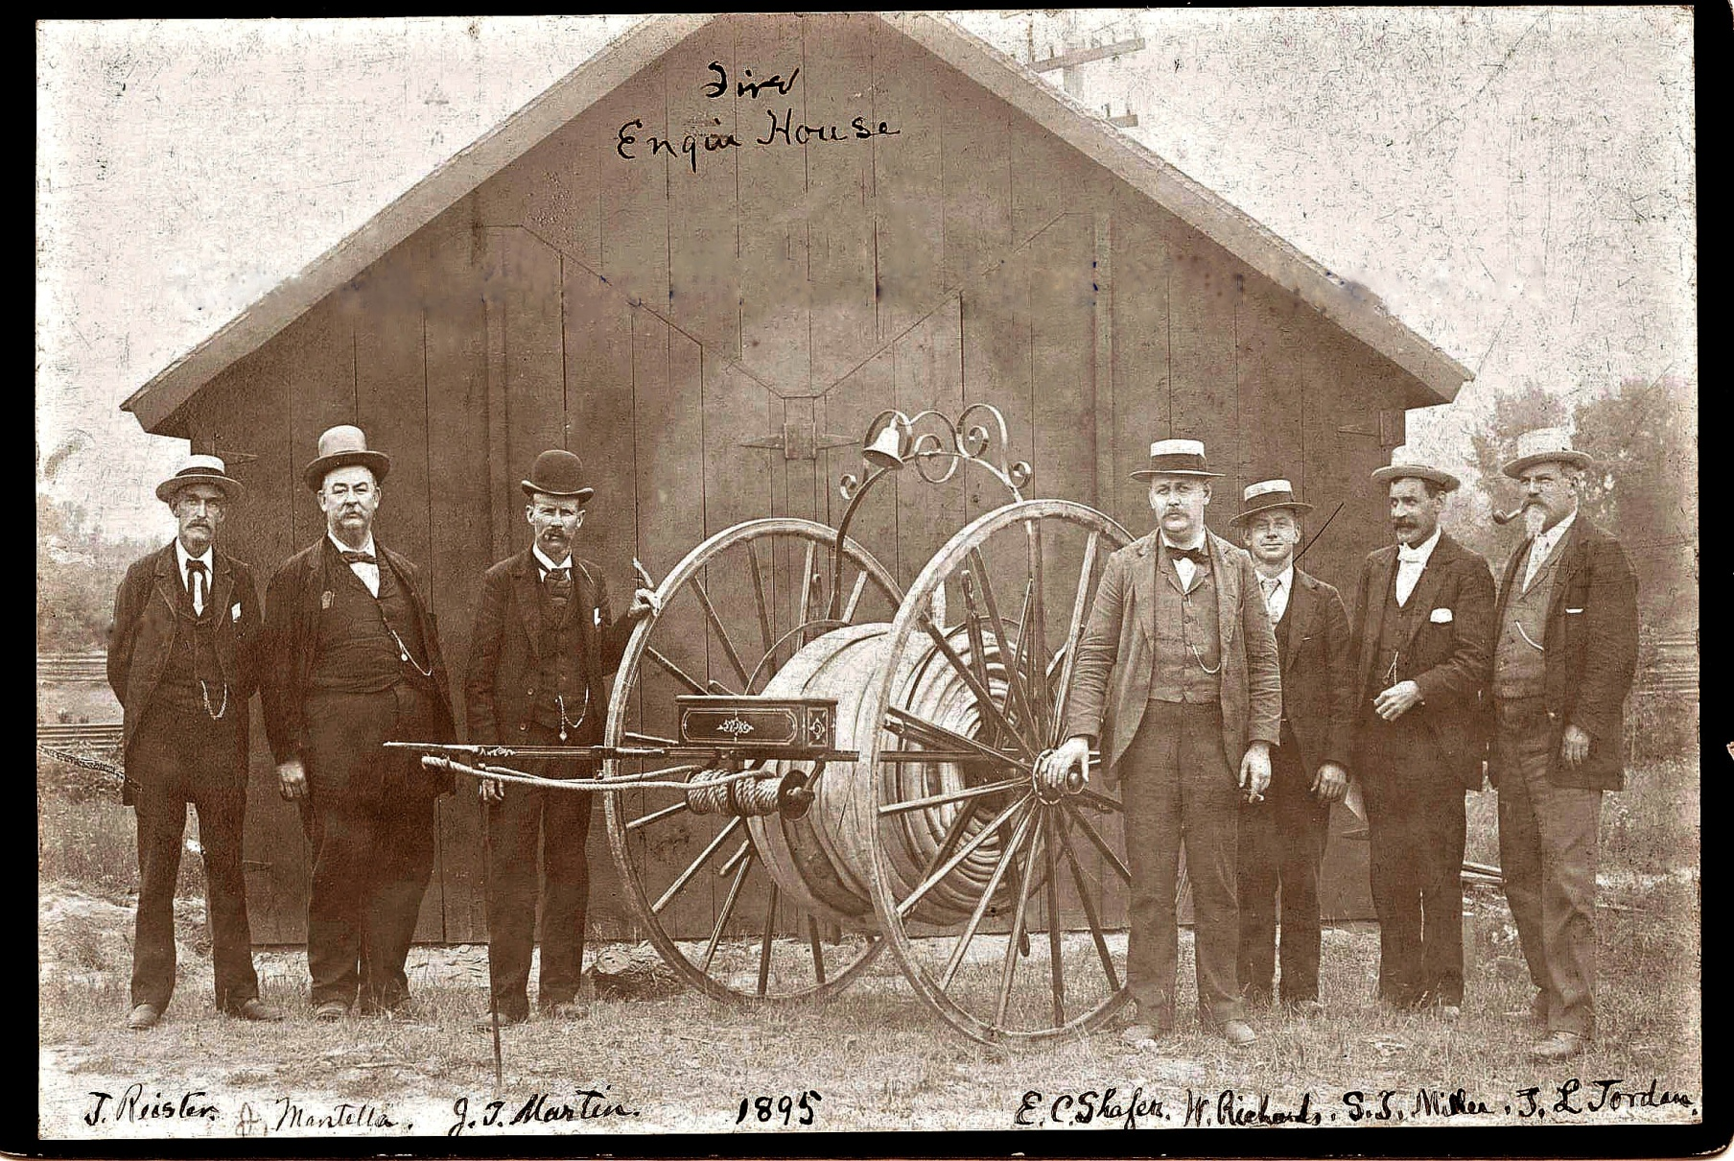
One of the First Wheel Houses for Brunswick 1895
The Reel house was at the bottom of 1st Ave on the south side of Potomac Street.
Notes:
L/R Mayor and Council, J.Reister, J.Mantella, J.T. Martin, Edward C. Shafer Mayor, W. Richard, S.T. Miller, T.L. Jordons. Mayor and Council of Brunswick.
Note: The railroad tracks in the rear. This fire house side on the south side of Potomac St across from 1st Ave.

Slide 6
1897
The first organized fire protection unit is formed in Brunswick. The equipment includes a Howe Hand Pumper, Hook and Ladder Wagon and a Wirt and Knox Heavy Hose Cart. Horses of the B.P. Crampton Company pull the apparatus for out of town fires. This unit will soon be phased out.
The hose cart had 72 inch wheels; complete weight was 530 lbs., carried 600 foot of 2.5 inch hose with hose roller off the back. New cost $228.00. The cart was hand pulled and had eighty foot of drag rope.
Notes:
After looking at photographs in the Historical Study by Edward D Smith of the C&O Canal for the US Park Services, It is believed the B.P. Crampton Company is what was known as the Old Mill that stood on the south side of the railroad as you entered the old bridge to Virginia.

Slide 7
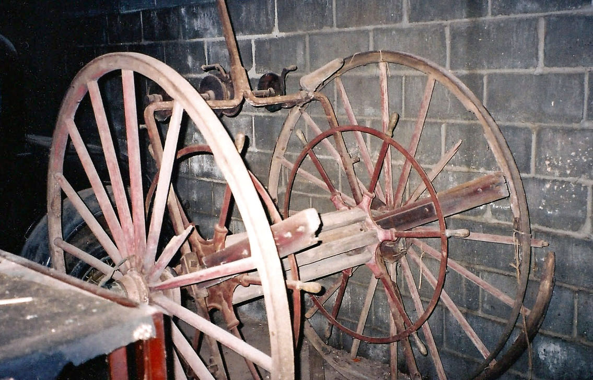
One of the first hose reel for Brunswick
After many years of disrepair the fire company repurchased the reel and member Clarence Webber took on the job of restoring the reel
Notes:
This is the condition of the hose reel after many years of disrepair the next frame will show the hard work done by Hot Dog Webber in restoring this reel.

Slide 8
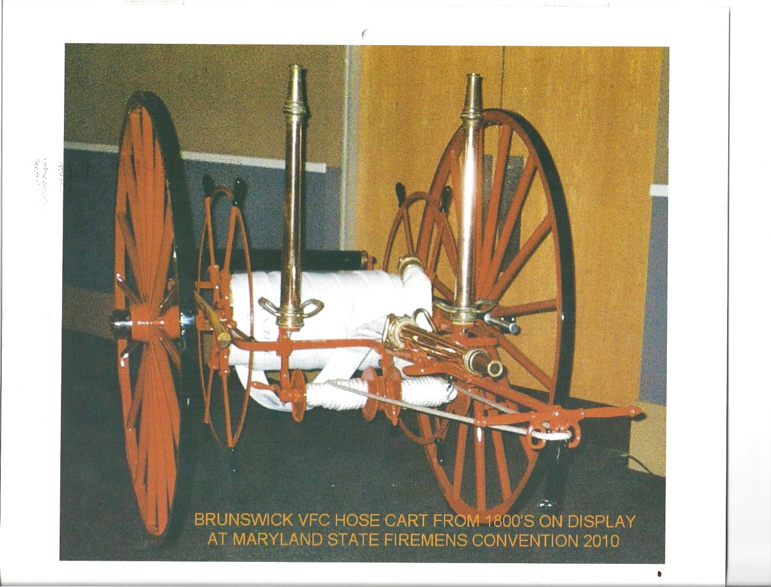
Restored Hose Reel that served Brunswick until motorized engines came to Brunswick
Restored By Clarence Webber a member of the Company

Slide 9
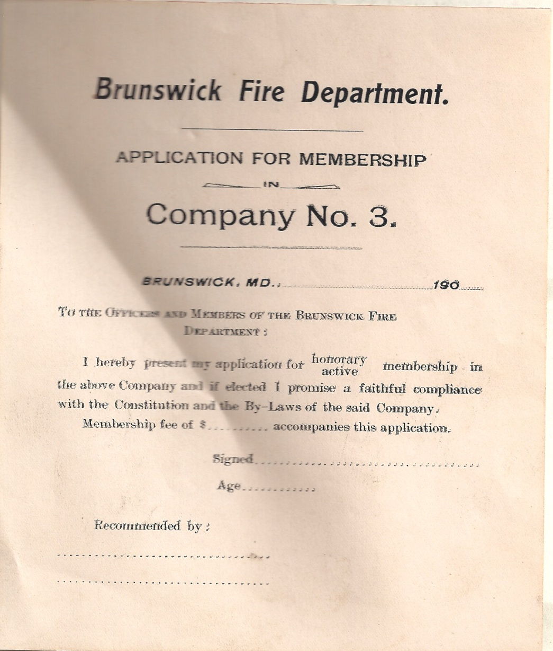
1900 Application for Membership

Slide 10
Democratic Advocate., Westminster Maryland May 29, 1908
At a special election at Brunswick the proposition to issue bonds to the amount of $15,000.00 for municipal water works system was carried by a majority of 194.

Slide 11
May 10th 1910
The First Official Brunswick Volunteer Fire Company is formed. Edward C. Shafer Editor of the Brunswick Herald news paper is president. A fire hall is erected under the supervision of Mr. Lorenzo S. Gardner. Across from the Imperial Theater on West Potomac Street.
In July 20th 1910, the Company joins the Maryland State Fireman's Association as the first official non-city fire company in Frederick County, Maryland becoming a charter member

Slide 12
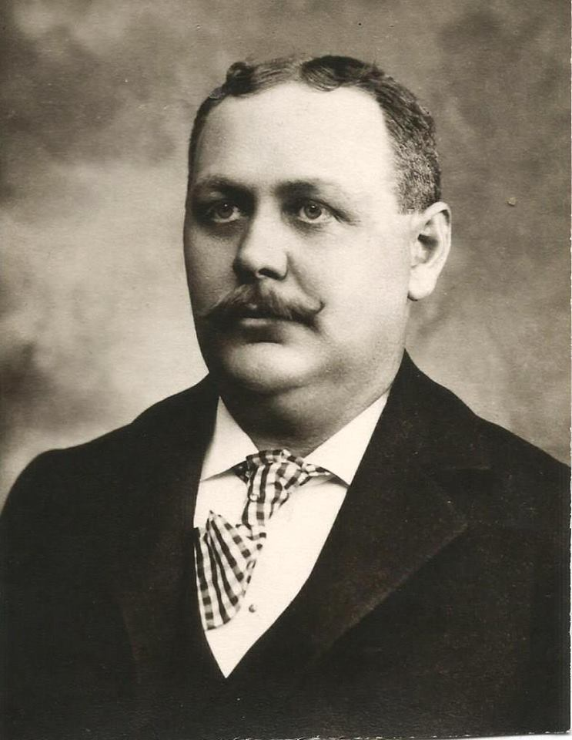
Edward C Shafer Past President of the BVFD 1910 and Mayor of Brunswick
Notes:
Information came from City of Brunswick, Maryland History Commission

Slide 13
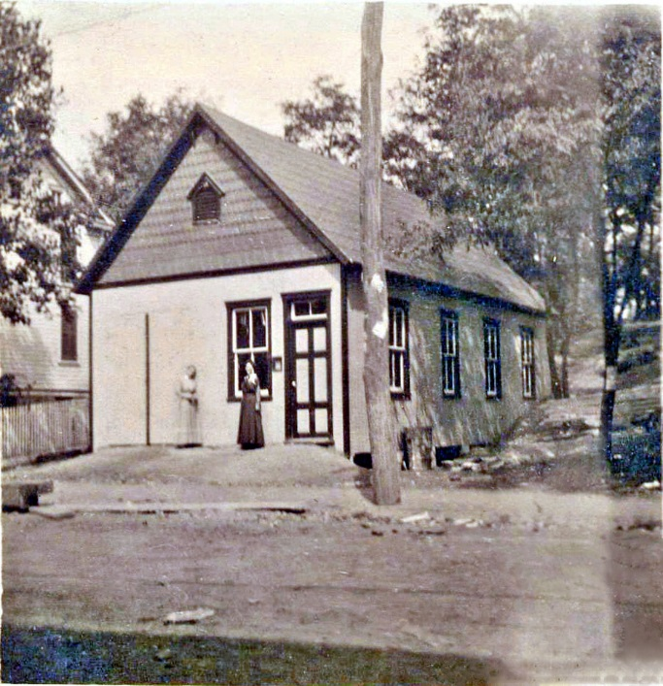
The first official Fire House of Brunswick built on the lot across from the Imperial Theater used between 1909 and 1928. A new building built later on this site. (Oct 7 1948)

Slide 14
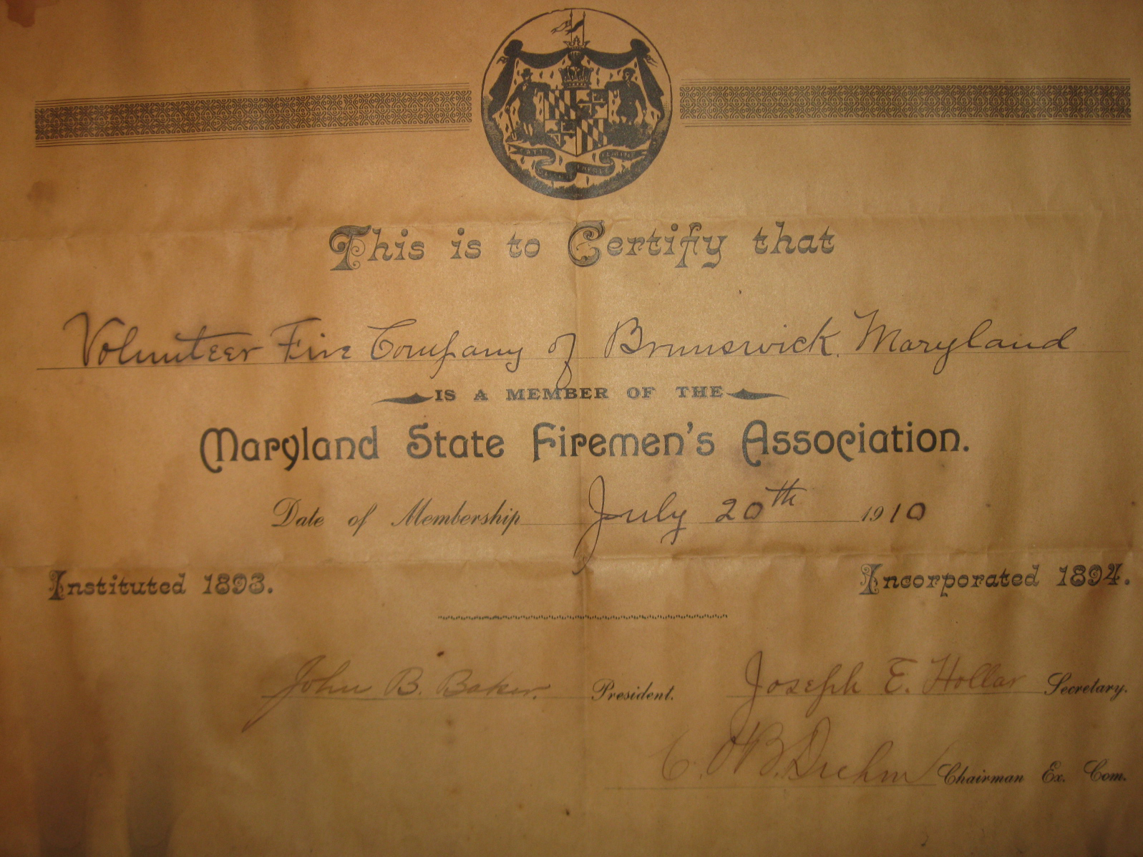
July 20th 1910
Notes:
John B Baker President of the Association, Joseph E Hollar Secretary and C.O.B. Drehm Chairman Ex Comm.

Slide 15
July 20th 1910 First large Fire to use Hose reels
B.&O. Warehouse Burned at Brunswick
It was a 40x80 Feet in size and Leased by George & Company.
“New Fire Company does splendid work---Flames held in check by three streams.”
The warehouse, 40x80 feet owned by the B&O Railroad at Brunswick and leased by Samuel W. George & Company., was destroyed by fire of unknown organ at 3:30 o’clock last Tuesday morning. Some coal bins nearby and a quantity of feed owned by the railroad were also consumed. The warehouse contained a carload of cement, a large lot of farm implements, along with some green groceries owned by J.H.Beachley, of Hagerstown, to whom part of the property was subleased. Loss between $2,000 and $3,000. George & Company placed their loss at $1,000.
The warehouse was situated along the railroad near a store building and close to a number of structures, one being the D.C. Winebrenner & Sons warehouse, operated as a branch of the Frederick wholesale concern.
The new fire company recently organized at Brunswick did fine service and confined the flames to the big warehouse. Three streams were played on the blazing structure Owing to the intense heat, train No.3 was unable to pass for half an hour.

Slide 16
September 18, 1912
The Brunswick fireman were given the opportunity to see themselves in motion pictures in the Red Men’s Hall, that place, Monday night when a reel of pictures taken during the recent convention(June 12, 1912) in Hagerstown was show for the benefit of the Brunswick Fire Department.

Slide 17
Westminster Maryland 12 June 1914
Brunswick Fire Company takes third place in a
Hook and Ladder race at Westminster, Maryland.
As many as 35 fireman attended this convention from Brunswick.
Notes:
Info taken from the Democratic Advocate News Paper Jun 14, 1914

Slide 18
Officers Of Brunswick Volunteer Fire Company 2 June 1917
President Harry Chew
Vice President Hiram N Werntz
Secretary J.R.Mathias
O.P. Karns Treasurer
Chief Ollie O. Baer,
Trustees Samuel T Hogan, Francis P.G Hill, Wm. Schnauffer, Stanley Virts, and Wilbur Sigafoose
Notes:
This information was taken from the Corporation papers of the company.

Slide 19
29th June 1917
The Company is incorporated as the Brunswick Volunteer Fire Company of Frederick County, Maryland, a non-profit, non-stock corporation. The first out of Frederick City fire companies.

Slide 20
1921
The Company is buying its first motor driven apparatus, a 1922 American LaFrance, 750 Gallon Pumper with
2. 1/2" hose. The purchase price is $12,500

Slide 21
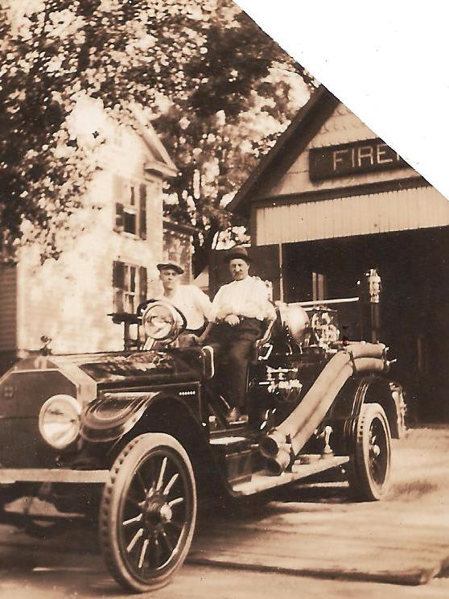
The first motorized fire truck for Brunswick note the hard rubber tires

Slide 22
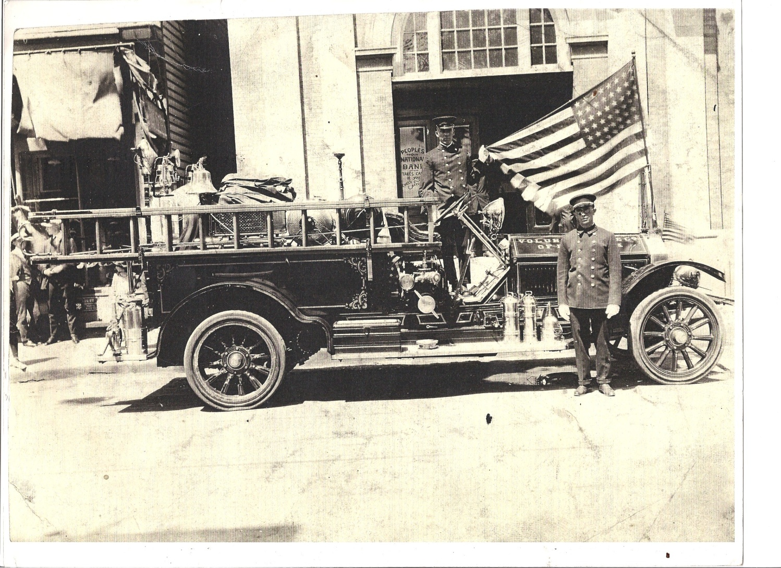
The First motorized Fire Truck For Brunswick
Sitting in front of the Peoples Nation Bank of Brunswick. On West Potomac Street.

Slide 23
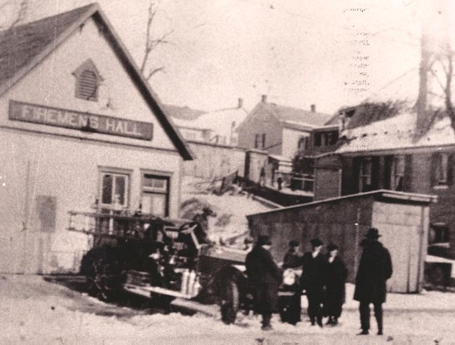
This is the first offical Fire House of Brunswick used between 1909 and 1928. A new building was built on this site much later (Oct 7 1948) at West Potomac Street
Notes:
Before the first firehouse there was what was called reel houses one on New York Hill across from Park Ave, one on Wenner’s Hill at F Street and Maple Ave, one at the bottom of First Ave on the south side of Potomac Street this one was built on stilts and one in the 600 block of West Potomac Street.

Slide 24
26 July 1917
Big Fire Near Brunswick, A large barn and wagon shed on the Andrew D Arnold farm near Brunswick, this county, with hundreds of bushels of grain,27 hogs, two calves, farming implements, ect. Were destroyed by fire Saturday night. All this season’s wheat crop was in the barn. The loss is estimated at $15,000.00 with insurance of about $4,000.00. A negro farm hand is accused of starting the fire, and disappeared.
Notes:
Catoctin Clarion News Mechanicstown, Md.

Slide 25
The Democratic Advocate., October 17, 1922
John R Mathias, Secretary of the Brunswick Vol Fire Company. Attempted to board the moving fire engine and fell beneath the wheels of the truck. He was taken to the B&O. Emergency hospital and later transferred to the Frederick City Hospital. Where the injured member was given attention. He suffered a broken leg near the hip.
Notes:
Democratic Advocate a Westminster news paper Oct 1922.

Slide 26
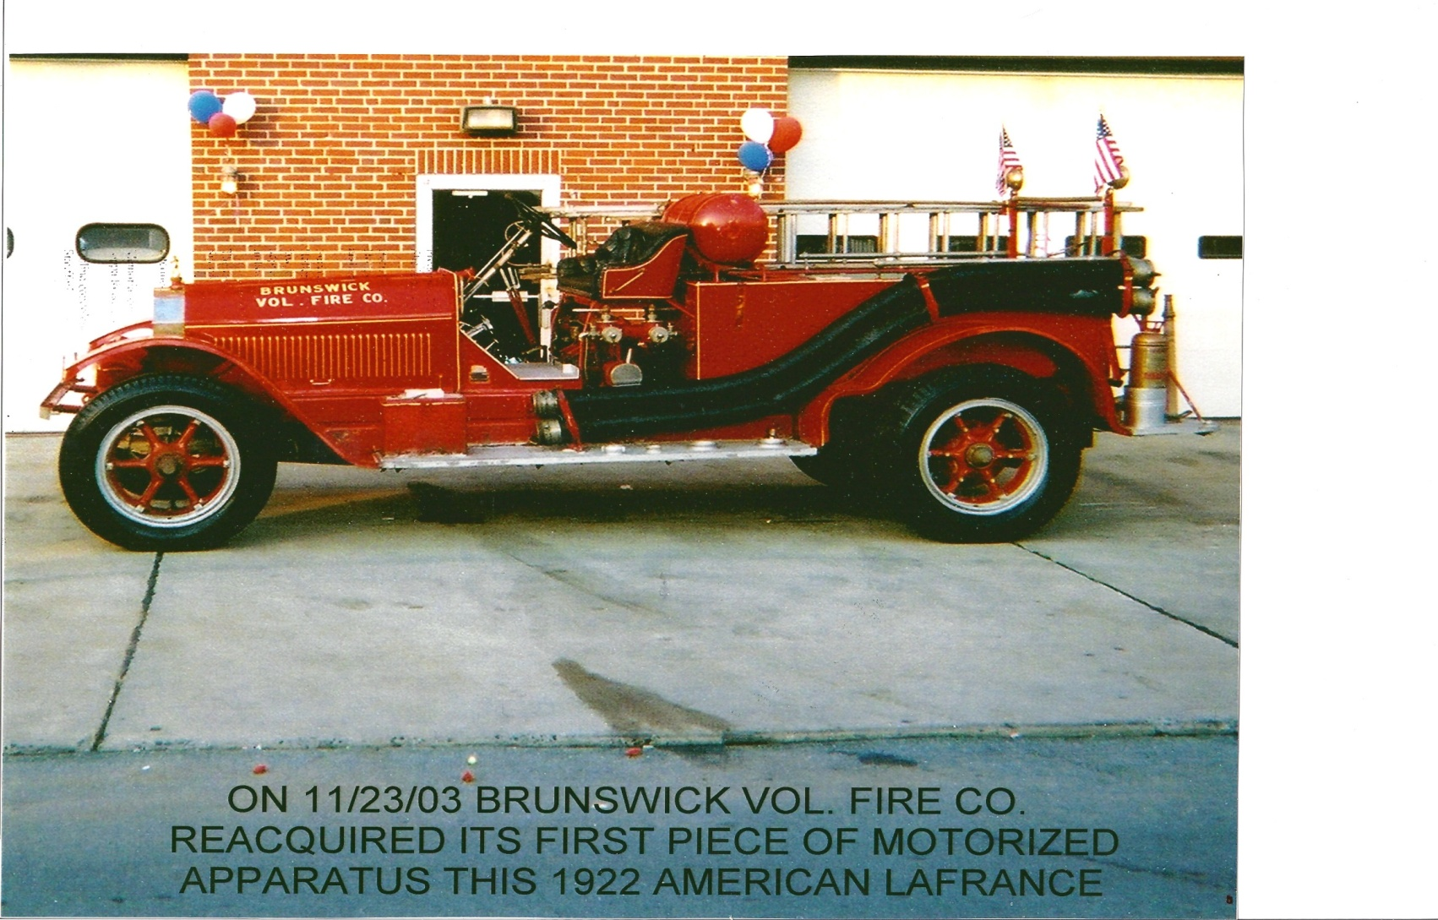
The first motorized fire engine for Brunswick

Slide 27
Officers for Company 5 date is about 1923

Slide 28
Officers for about 1923
President E.C. Shafer
1st Vice President H.A.Burns
2nd Vice President E.L.Feete
Secretary J.R. Mathis
Treasure C.F.Feete
Sergeant At Arms James Eury
Chaplain Rev E.E.Burguess
Chief W C Nuse
Directors
J.Henry Rinker , A.L.Horine, E.C.Compher
E.p. Orrison and O.W.Keyser
Notes:
The date for these Offices was taken from a Men’s Business Directory of Brunswick. On the add is a picture of the 1922 LaFrance the add said this is a new engine.

Slide 29
Feb 1928
The City of Brunswick turns over the building on North Delaware Avenue, to the Company to use as a fire station. The old garage and lot on Potomac Street across from the Imperial Theater that was used to house the fire equipment will later (1948) become the property where the Brunswick Volunteer Fire Company builds a new building.

Slide 30
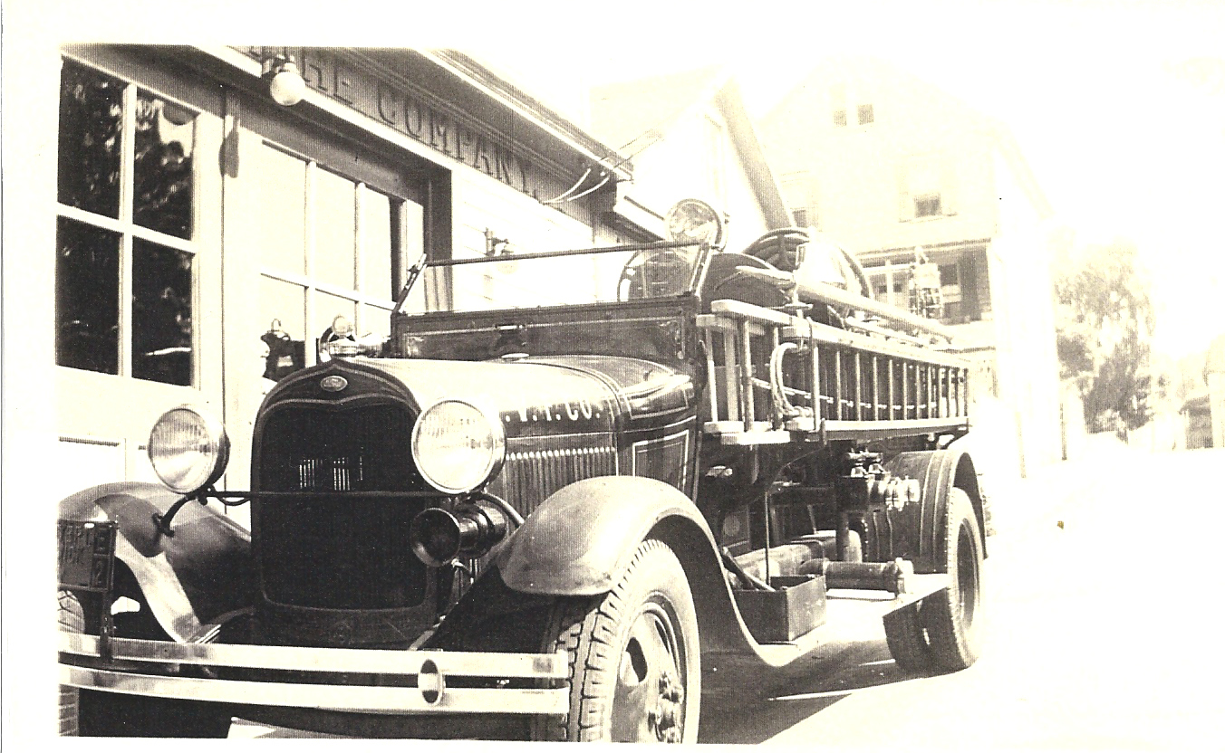
Brunswick New Model AA Ford Pumper, the second motorized pumper

Slide 31
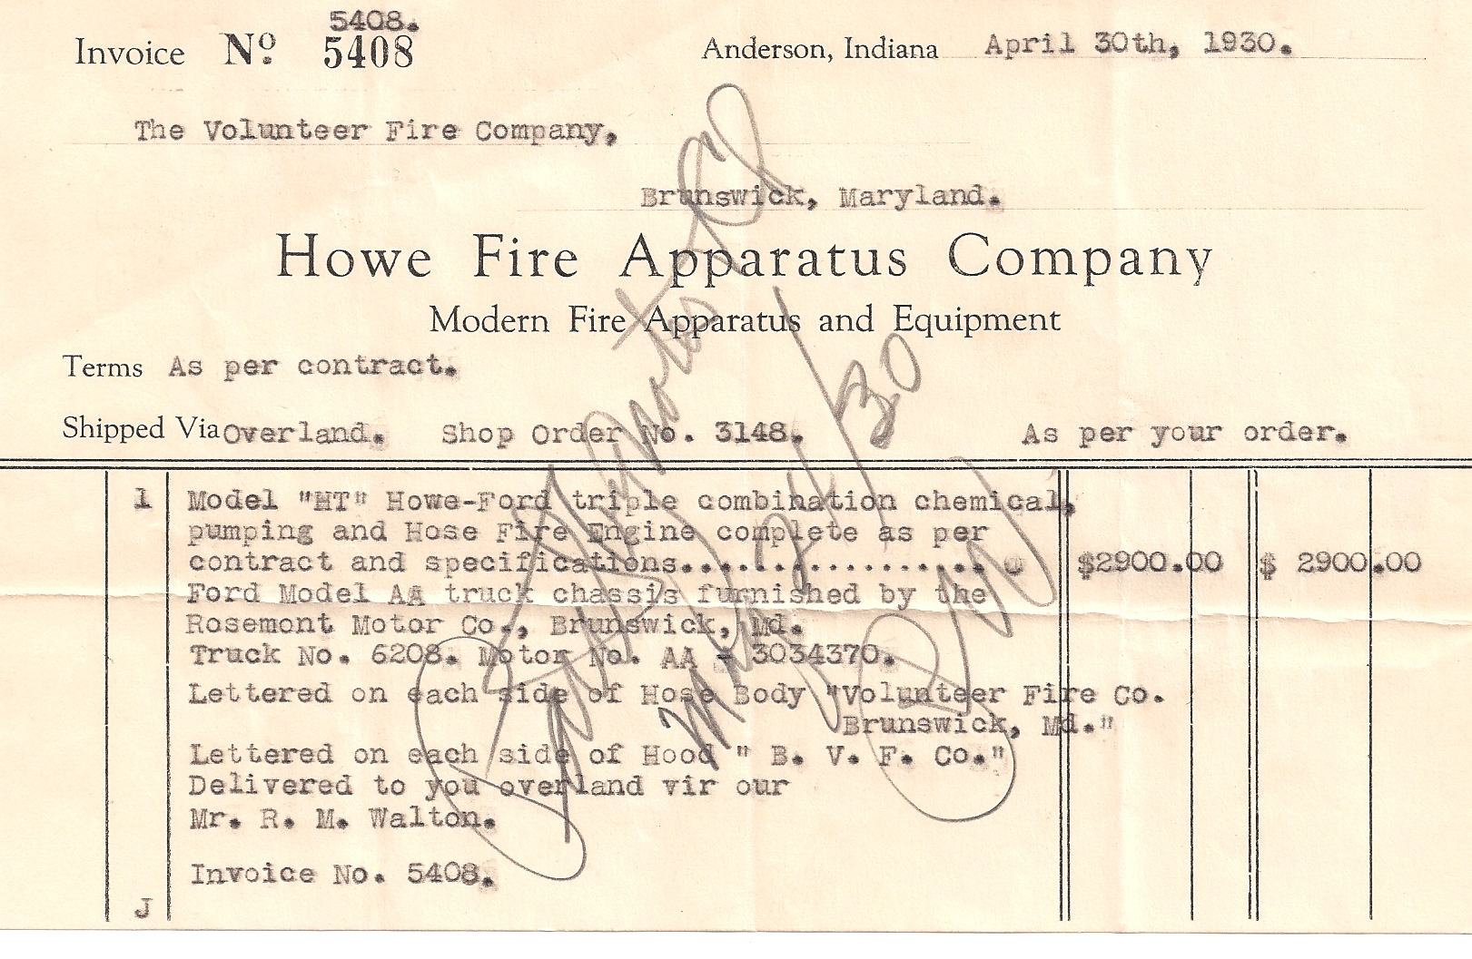
April 30, 1930 Brunswick purchase of a new Fire truck from Rosemont Motors in Brunswick
Model HT Howe-Ford AA with a Chemical pumping.

Slide 32
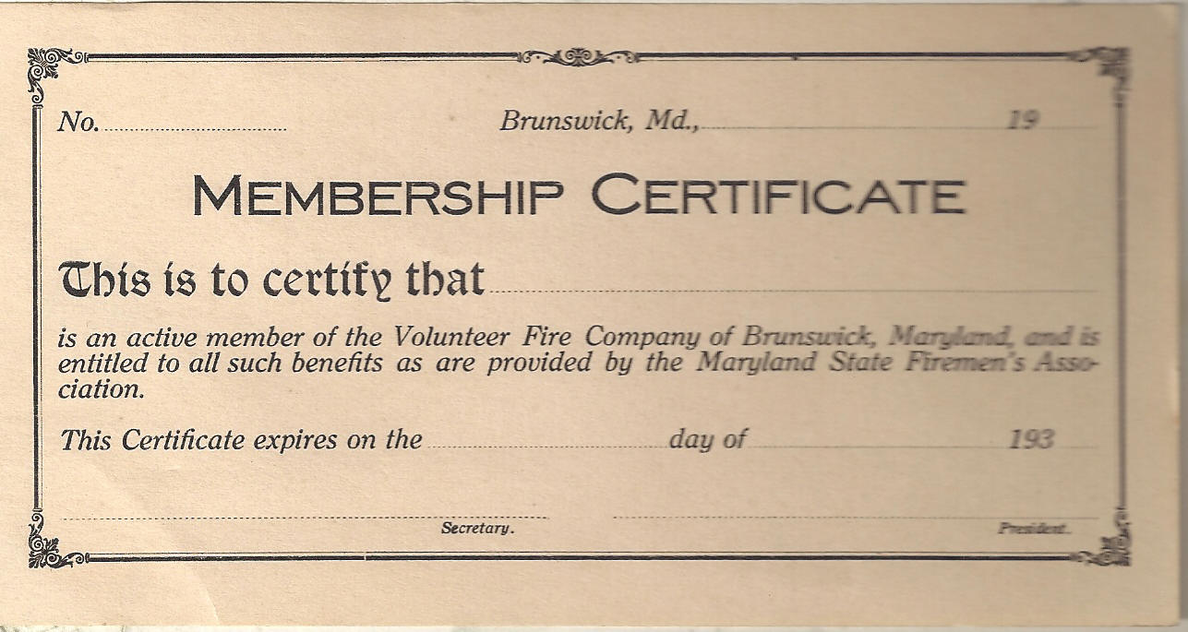
1930 Membership Certification

Slide 33
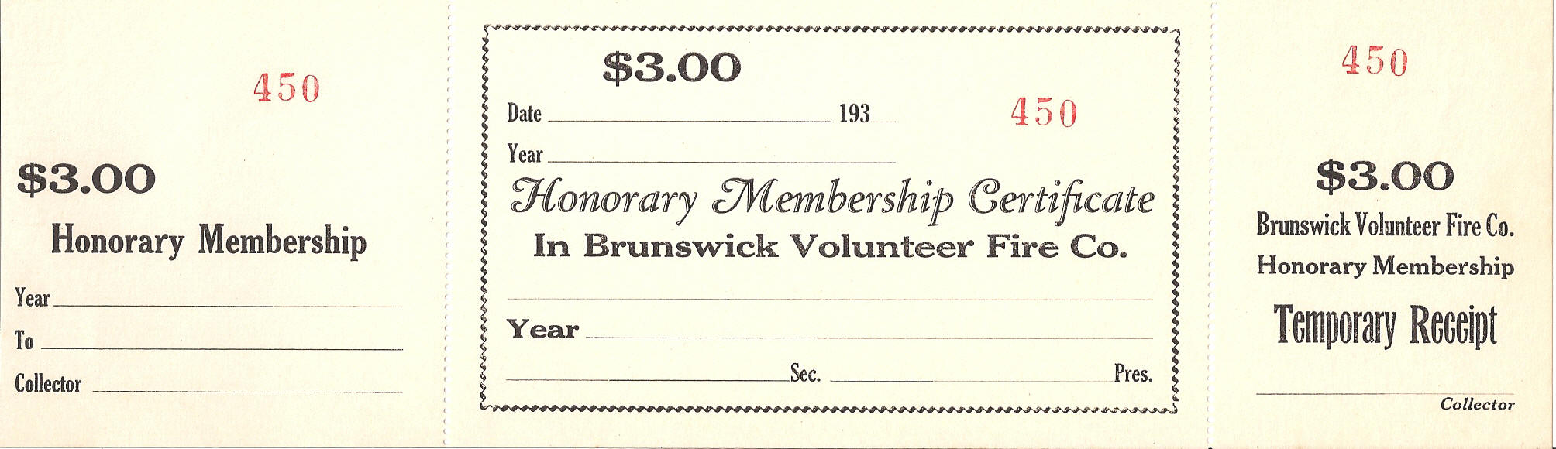
1930’s Honorary Membership Certificate

Slide 34
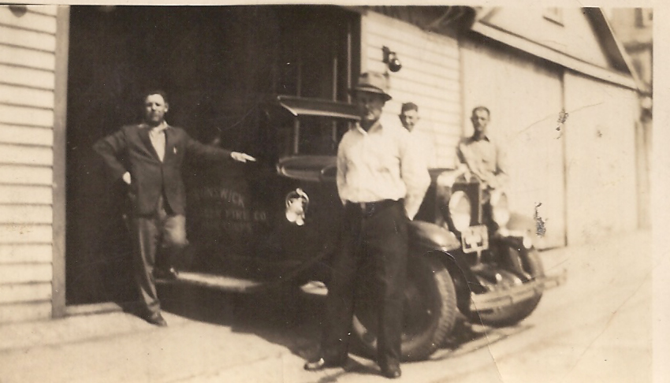
1930 Chevrolet Pickup believed to be used as a rescue pickup

Slide 35
Brunswick Volunteer Fire Company Membership List for 1930
Roby A.F. Roby J.S Cary Howard
Barker Claude Grams Calvin Magaha John
Grams G.E. Wenner Herbert Runkles Norman
Conner Lester Cribs Harry R Coffar J.B.
Walker Isaaca E Hawkins Donald Merrimen Leon
Barnhart Claude Anderson Albert Jones Harman
Rinker C.E. Burch Edgar Burch Ernest
Decker Vernon Donavan J.A. Day H.
Moler H.I. Willen G. Smith H.A.
Grams Roy E. Moler R.G. Hawes G.W.
Coffman C.B.

Slide 36
6 July1932
The Ladies Auxiliary becomes a Charter member of the Maryland State Firemen’s' Association.

Slide 37
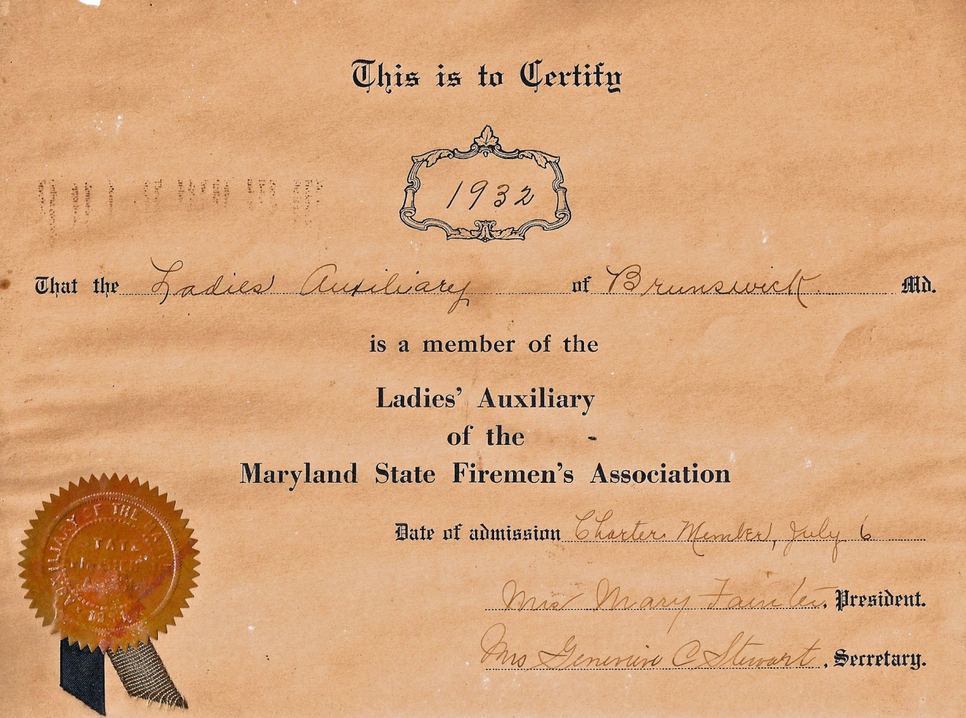
Ladies Auxiliary 6 July1932 becomes a member of the Maryland State Ladies Auxiliary.

Slide 38
1932
In this year the company formed a Drill Team with the following officers of the team. Business Mgr, Stanley T. Virts, Captain, Grayson Cummings, Lieutenant, James Schamel, Secretary, J.W. Gladstone
18 May 1932 will be Election Day, for the team. R.D Funk elected Captain, Floyd Strickler elected Lieutenant and H. Curry elected Secretary.

Slide 39
9 May 1934
Member of the Drill Team as of 9 May 1934 are:
HL Barger, RD Funk, Fred Shafer, CB Langley, HE Cannon, CN Beacht, Walter S Rice, Eugene B Smith, GW Smith, DF Strickler, JW Gladstine, CW Shafer, Glen Weller, John Morris, J Schamel, W Connor, JB Coffman, SD Langley, Donald Hawkins, J Shaby, CA Strickler, RM Hutts, LC Connor, Stanley T Virts, Roy Cannon and H Curry.

Slide 40
December 3, 1935
New Steel Rims are received for the Pneumatic tires replacing the original solid-tire wheels on the American LaFrance Pumper. The cost of the rims are $258.75 this is not including the new tires.

Slide 41
1936
Over 100 fire calls will be made this year.

Slide 42
Engineers or Drivers for the Company
Engineers (Drivers) for the Fire Company as early as we have a record for is 1930
1930 to 1937 F.J. Shafer who was paid a sum of $40.00 Dollars every two weeks
1937 until passing away 26 May 1966 Walter S Rice who was paid in 1947, a sum of $55.00 every two weeks later increased to about $74.00 every two weeks.
Luther Darrell Snoots who was a part time driver who relieved the full time drivers.

Slide 43
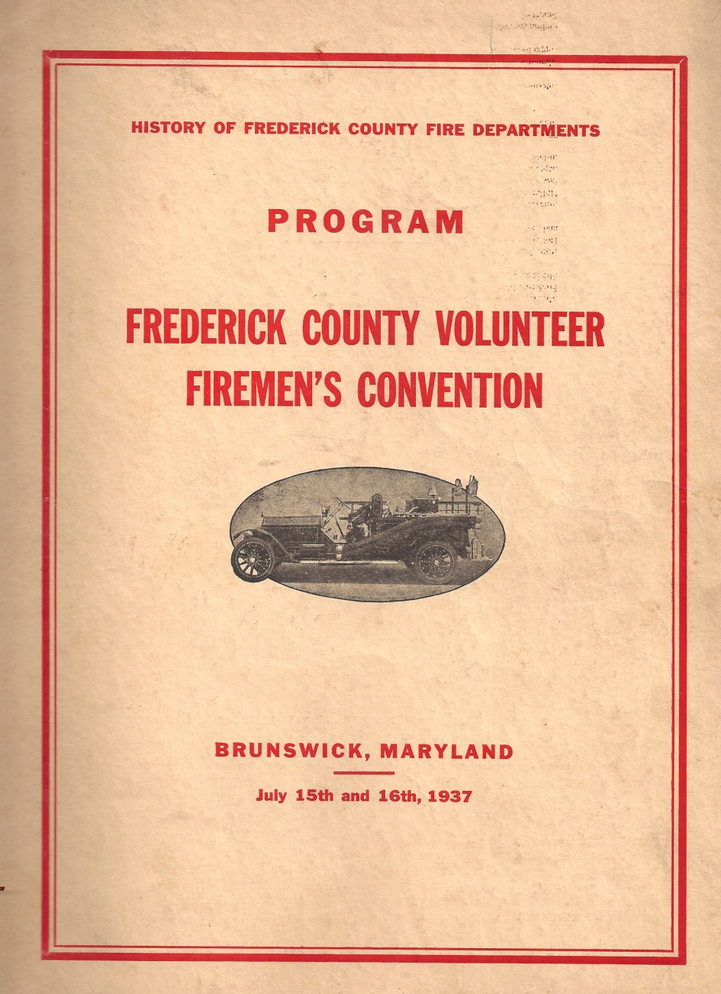
15th/16th July 1937 Frederick County Fireman’s Convention is at Brunswick

Slide 44
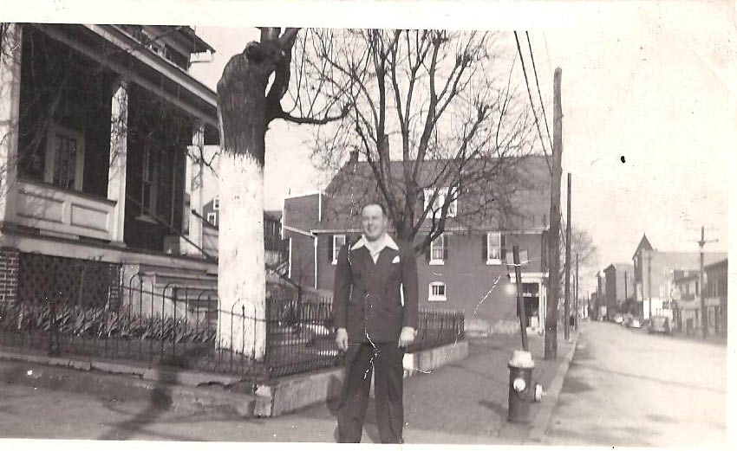
H.E. Harvey(Sonny) Cannon
Before the New Fire Hall was Built

Slide 45
June 1939
The Company has purchased a 1938 Ford Howe 350 Gallon Piston pumping engine with a booster tank. It carries 1,000 feet of 2 1/2" hose. It will be used to get to out-of-town fires over bad country roads. The truck is Blue! Truck later sold to the town of Brownsville, Maryland.

Slide 46
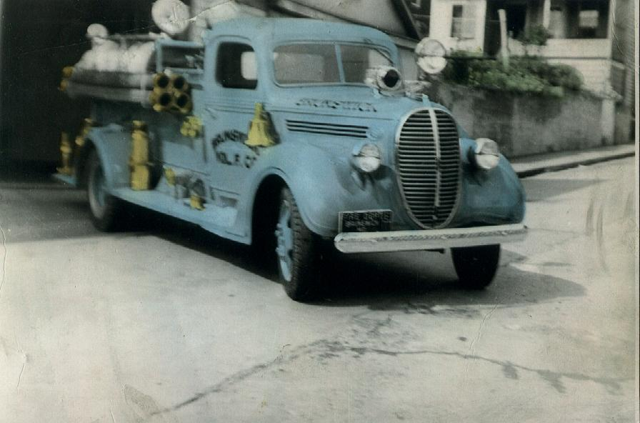
1938 Ford Howe pumper

Slide 47
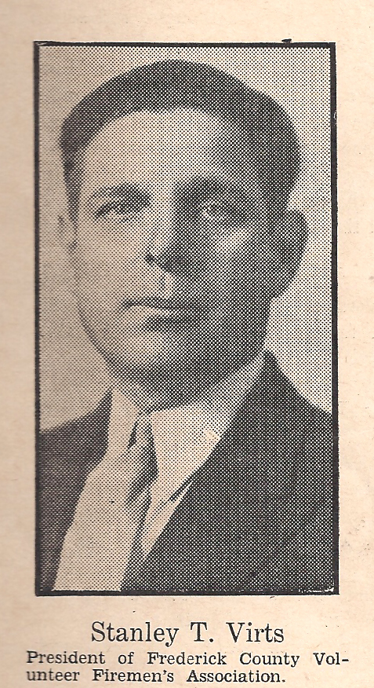
1940
Stanley T. Virts is President of the County Firemen’s Association and also the BVFD Fire Co.

Slide 48
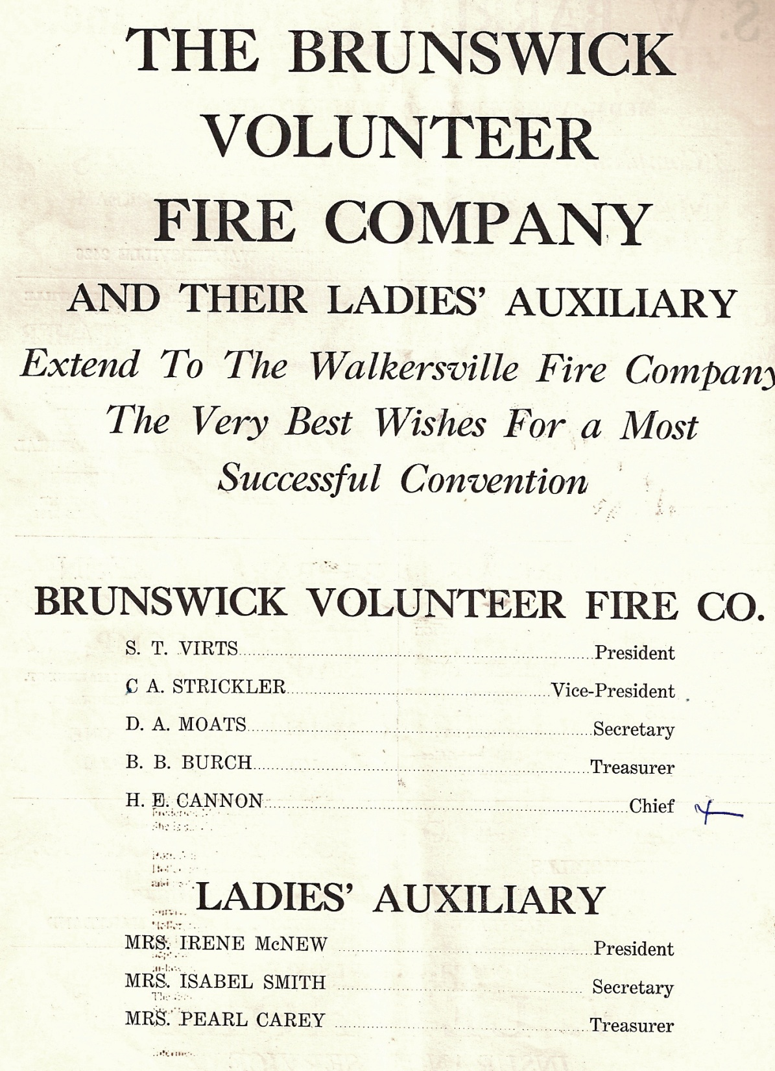
1940 Officers of the Brunswick Volunteer Fire Company
Notes:
1940 Officers of Brunswick Volunteer Fire Company

Slide 49
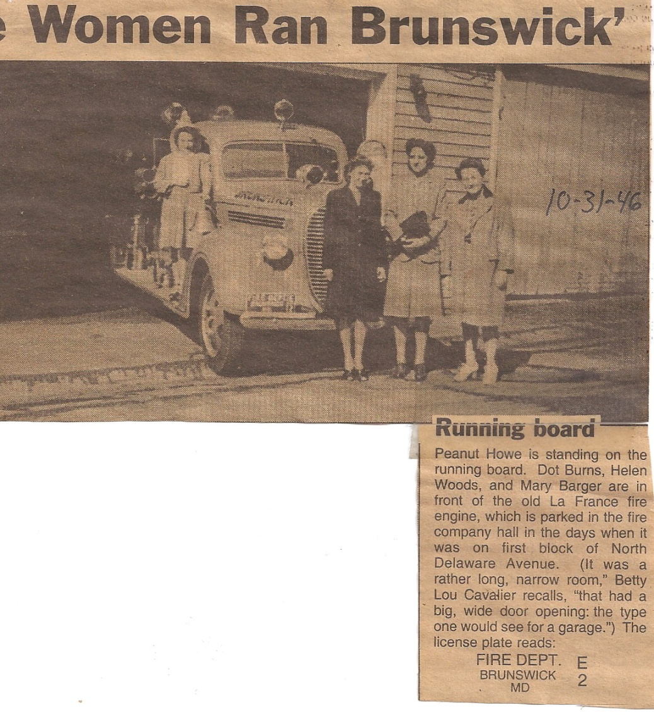
In the years of WW11 women did a lot of men’s jobs

Slide 50
1945
President Stanley T Virts
V President John H Moore
Treasurer George W Strickler
Secretary F L Spitzer
Chief 5 Harvey E Cannon

Slide 51

Stanley T Virts Past President 1945

Slide 52
1945 John Howard the first black firefighter for BVFD

Slide 53
1946
President Stanley T Virts
V President John H Moore
Secretary Frank L. Spitzer
Treasurer George W. Strickler
Chief 5 Harvey E. Cannon
Trustees Martin M Blessing
George Wm. Thomas

Slide 54
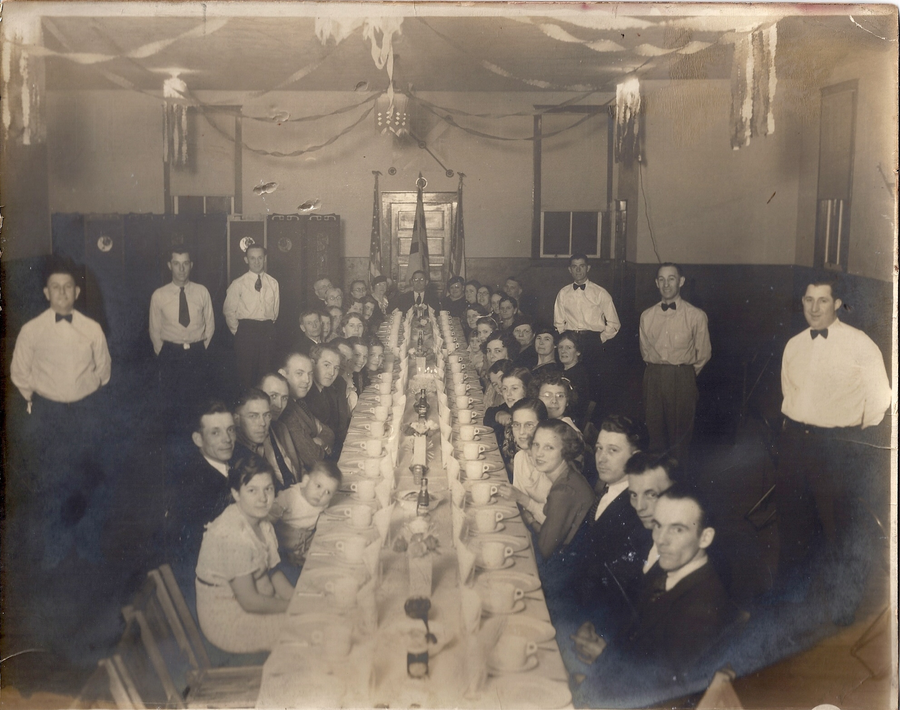
Banquet about 1946
Notes:
Right seated Conner,Conner, George Strickler the rest unknown
Right Standing Floyd Strickler Freddy Moore unknown
Left Seated ?? Connor, ?, Bowers, Donald Dixon,??????
Left Standing unknown ???
At the head of the table is believed to be Stanley Virts

Slide 55
Jan 25 1946
Special Meeting: Discussion of the Fire Company moving into a new Community Building to be built on “A” Street.
July 26, 1946
With the possibility of the Brunswick Hospital closing, ambulance service for Brunswick is discussed at a special meeting.

Slide 56
Officers for 1947/48
President Stanley T Virts
V President Glenn Cooper
Secretary Martin M Blessing
Treasurer George W. Strickler
Chief 5 Harvey E. Cannon
Notes:
Glenn Cooper the father of Herald, Mary Ann and Donald.

Slide 57
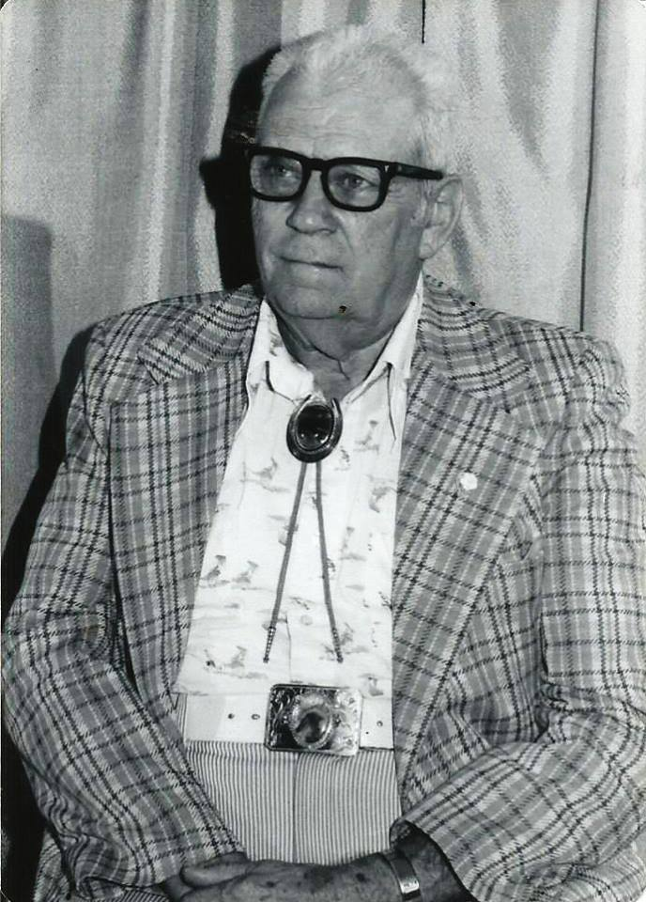
Glenn I Cooper Past Vice President of the Brunswick Vol Fire Company 1947/48

Slide 58
Nov 20, 1947
Motion is made by H.E. Sonny Cannon and carried at a membership meeting to build a new fire hall and auditorium on 300 block of West Potomac Street. This will be built largely by volunteer workmanship. Lee Keller gave a cost of construction at $25,000 dollars.

Slide 59
1948/49
President Eugene B Smith
V President Glenn Cooper
Secretary Martin M Blessing
Treasurer George W Strickler
Chief 5 Harvey E Cannon
January 5, 1948
Meeting called to organize building committee, appointments were as follows: Sonny Cannon, Chairman, S.T. Virts, Vice Chairman, Martin Blessing, Secretary, George Strickler, Treasurer, and Richard Magalis, Solicitor.

Slide 60
October 7, 1948
The old garage and lot on West Potomac Street used to house the fire equipment in 1923 thru 1928 become the property where the Brunswick Volunteer Fire Company will build their new fire house.
Footers for building are completed and block lying is to start Monday. Brunswick Moose Lodge is constructing a new building; lumber from the old is donated to Fire Company and used on the roof and sub floor of new fire house.

Slide 61
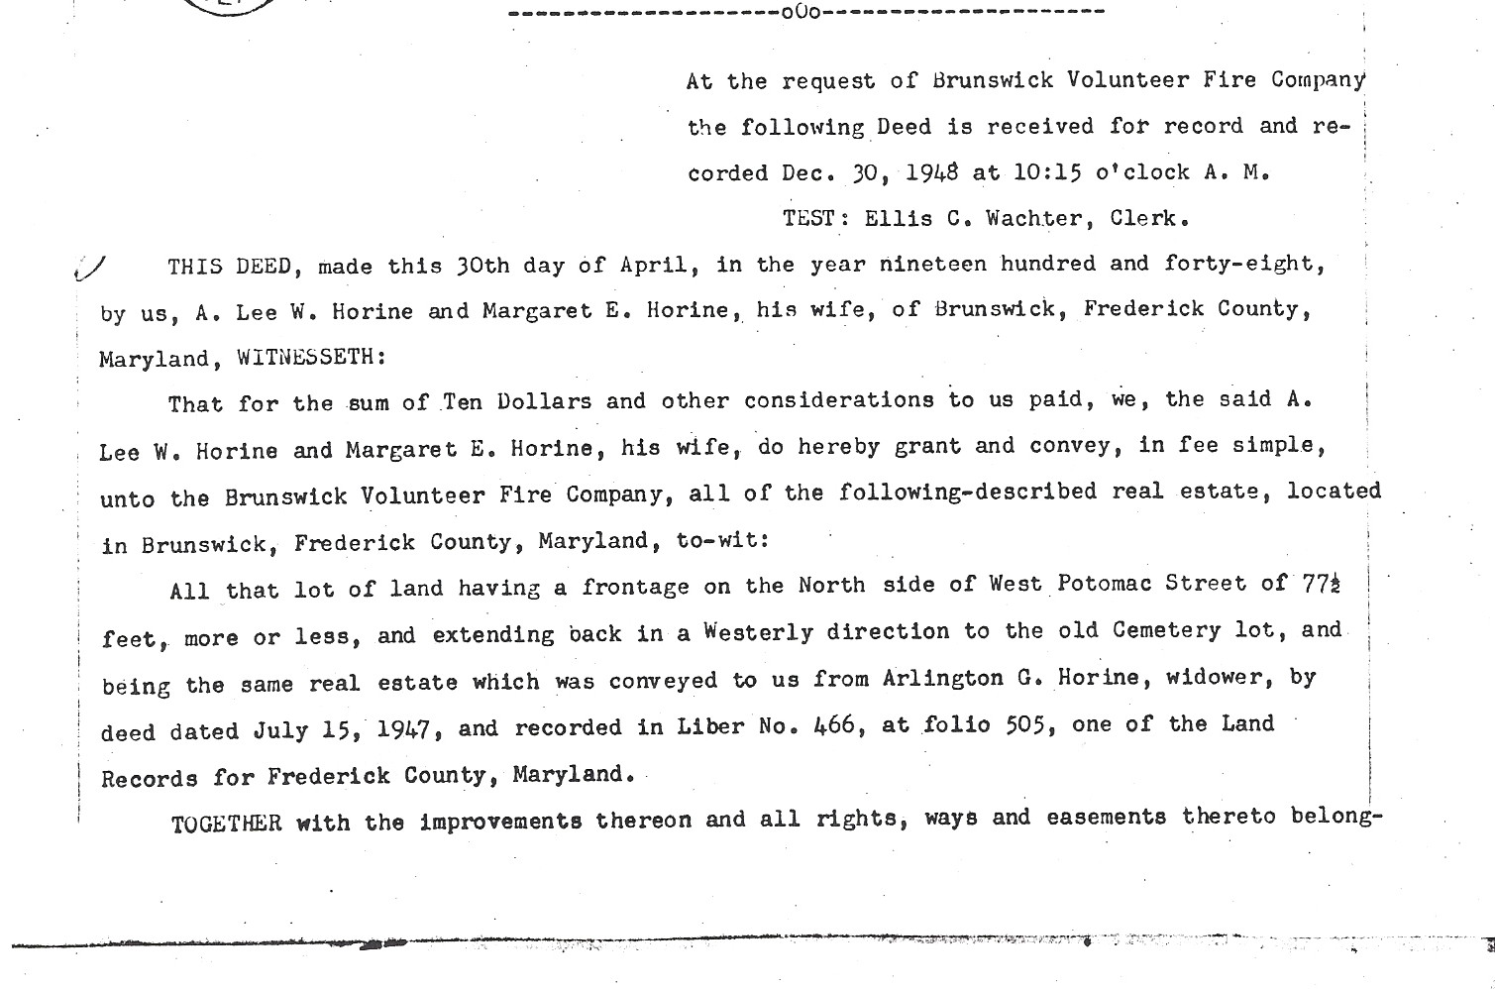
Dec 30th 1948 Deed to Potomac Street Property From Lee Horine, cost of property was 10.00

Slide 62
Officers for 1949/50
President Eugene Smith
V President Wilbur Thomas
Secretary Martin M Blessing
Treasurer George W. Strickler
Chief 5 Harvey E Cannon

Slide 63
April 1949
The Company moves into its new Potomac Street quarters (still not complete). The auditorium, once completed will be a show place for some of the biggest dance bands in the country. Included among performing artists in this hall will be Jimmy Dean, Patsy Cline, Roy Clark, George Jones, Billy Grammer, Les Elgart, Les Brown, Tommy Dorsey, Guy Lombardo, Tex Ritter, Lester Flatts and Earl Scrugg, Don Reno, George Hamilton IV, Tex Ridder, Little Jimmy Dickens to name a few.

Slide 64
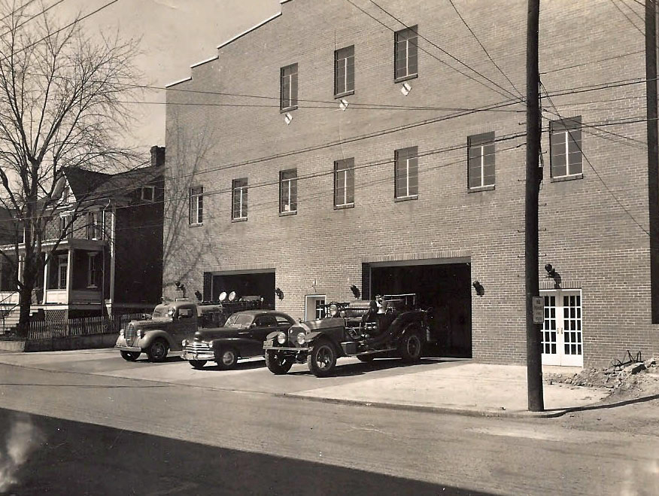
New Fire House on West Potomac Street
1949
Notes:
The Chevy car belonged to Walter S Rice. Note the letter Brunswick Vol Fire Company are not on the building yet.

Slide 65
1950
The first ambulance, privately operated, is housed at the fire company. This will be short-lived, however, and ultimately the ambulance service in the community will be formed as a separate company, Ambulance Company 19.
Hardwood flooring to be installed in upstairs auditorium by Mr. Demory at a total cost of $2957.40 dollars.
President Eugene Smith
V President Wilbur Thomas
Treasurer George W Strickler
Secretary Martin M Blessing
Chief 5 H.E. “Sonny” Cannon

Slide 66
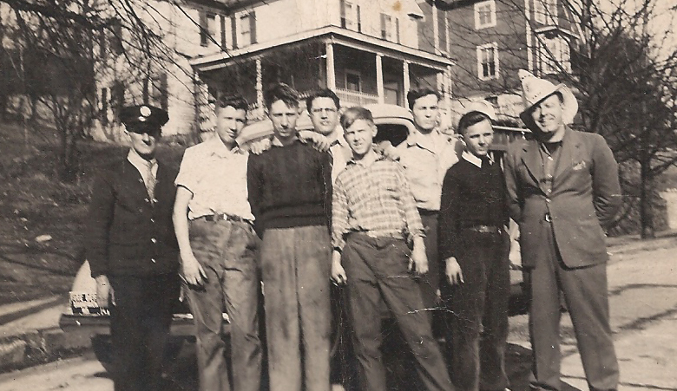
Walter S Rice, Jim Welty, Moonie Forest, Donald Smith, Phillco Phillips, two unknown, and Sonny Cannon
Notes:
Picture taken on East A Street in front of the Strailmen House

Slide 67
1951
President Eugene Smith
Vice President Wilbur Thomas
Secretary Martin M Blessing
Treasurer George W Strickler
Chief 5 H.E. Sonny Cannon
Harvey E. Cannon is appointed as Auditorium Chairman. Mr. Cannon served as chairman for 26 years after this appointment.
The office of Financial Secretary is voted on and added to the by-laws.

Slide 68
1952/1953
On November 18, 1953, a well-attended ceremony was held in the Fireman’s Banquet room of the fire hall. The ceremony was the burning of the mortgage for the fire hall by former President and now Mayor Stanley T. Virts.
********
The new American LaFrance truck is put into service. This new Class-A pumper will eventually be converted into a tanker. It will be in service for 28 years.
********
President Eugene Smith
Vice President Wilbur Thomas
Financial Secretary Harry E. Nicholson
Secretary Russell McMurry
Treasurer George Strickler
Chief 5 H.E. Sonny Cannon

Slide 69
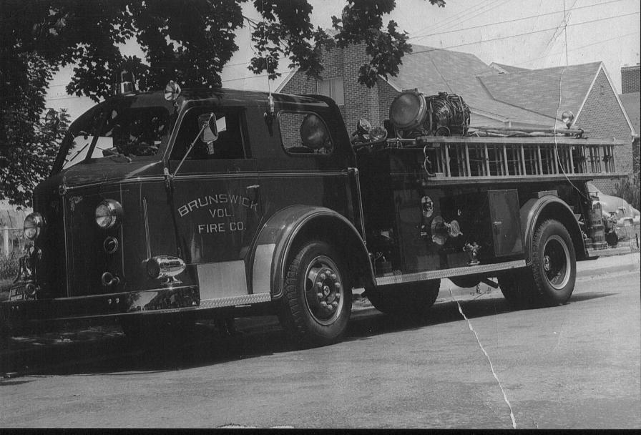
1953 American LaFrance

Slide 70
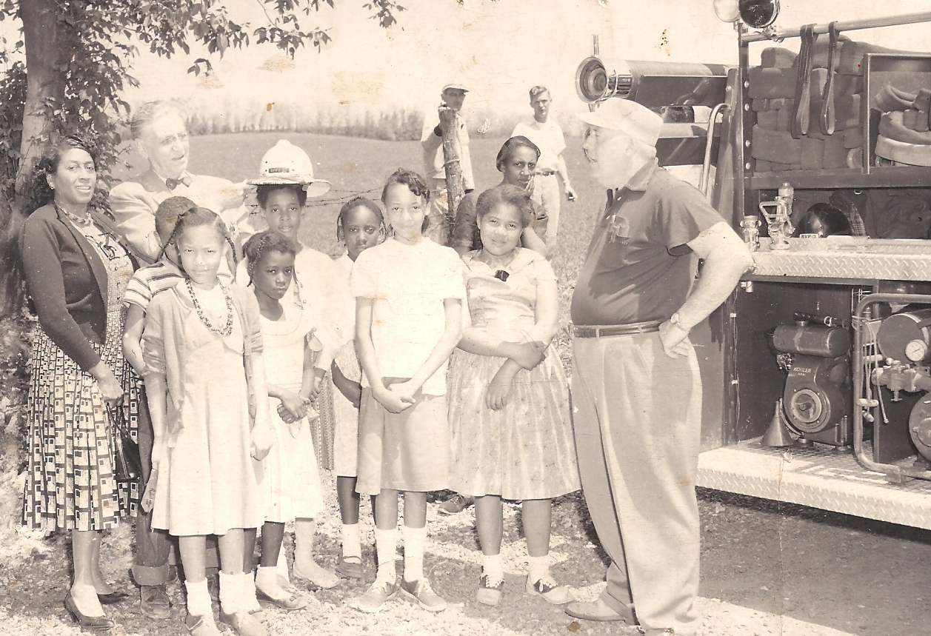
Mrs. Robinson, Mayor Cummings, And Sonny
Notes:
Ms. Robinson the teacher, Mayor Cummings placing hat on child. Harwood “Dr” Watson and Philco Phillps are in the background and H.E.(Sonny) Cannon.

Slide 71
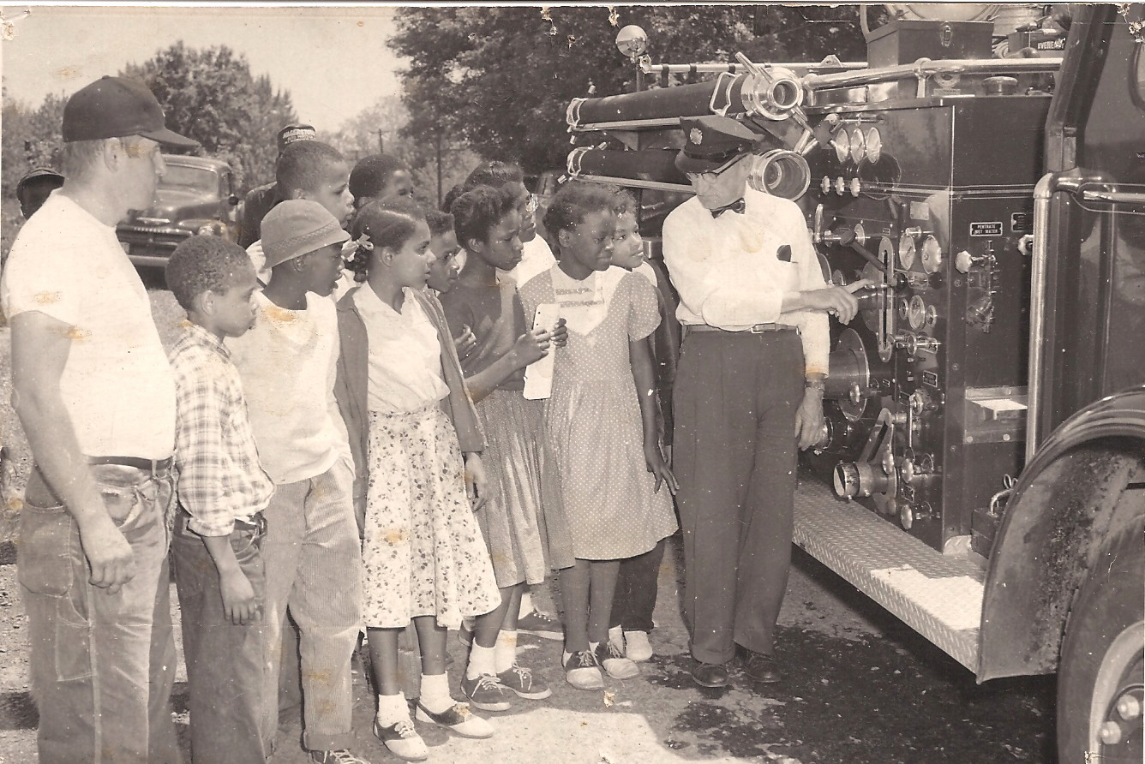
Walter Rice & Pete Virts showing off new Fire Truck
Notes:
L/R Pete Virts children on the end Walter Rice engineer

Slide 72
November 3, 1954
Installation of radios in the trucks has now been accomplished. Central Fire and Rescue Communications is established with the central alarm board in Frederick County, Maryland. All fire calls will be dispatched from the Central Alarm in Frederick.
******
President H.E.Nicholson
Vice President Paul Tritapoe
Financial Secretary Charles R Virts
Secretary Roy Lee George
Treasurer Floyd Strickler
Chief 5 H.E. Sonny Cannon

Slide 73
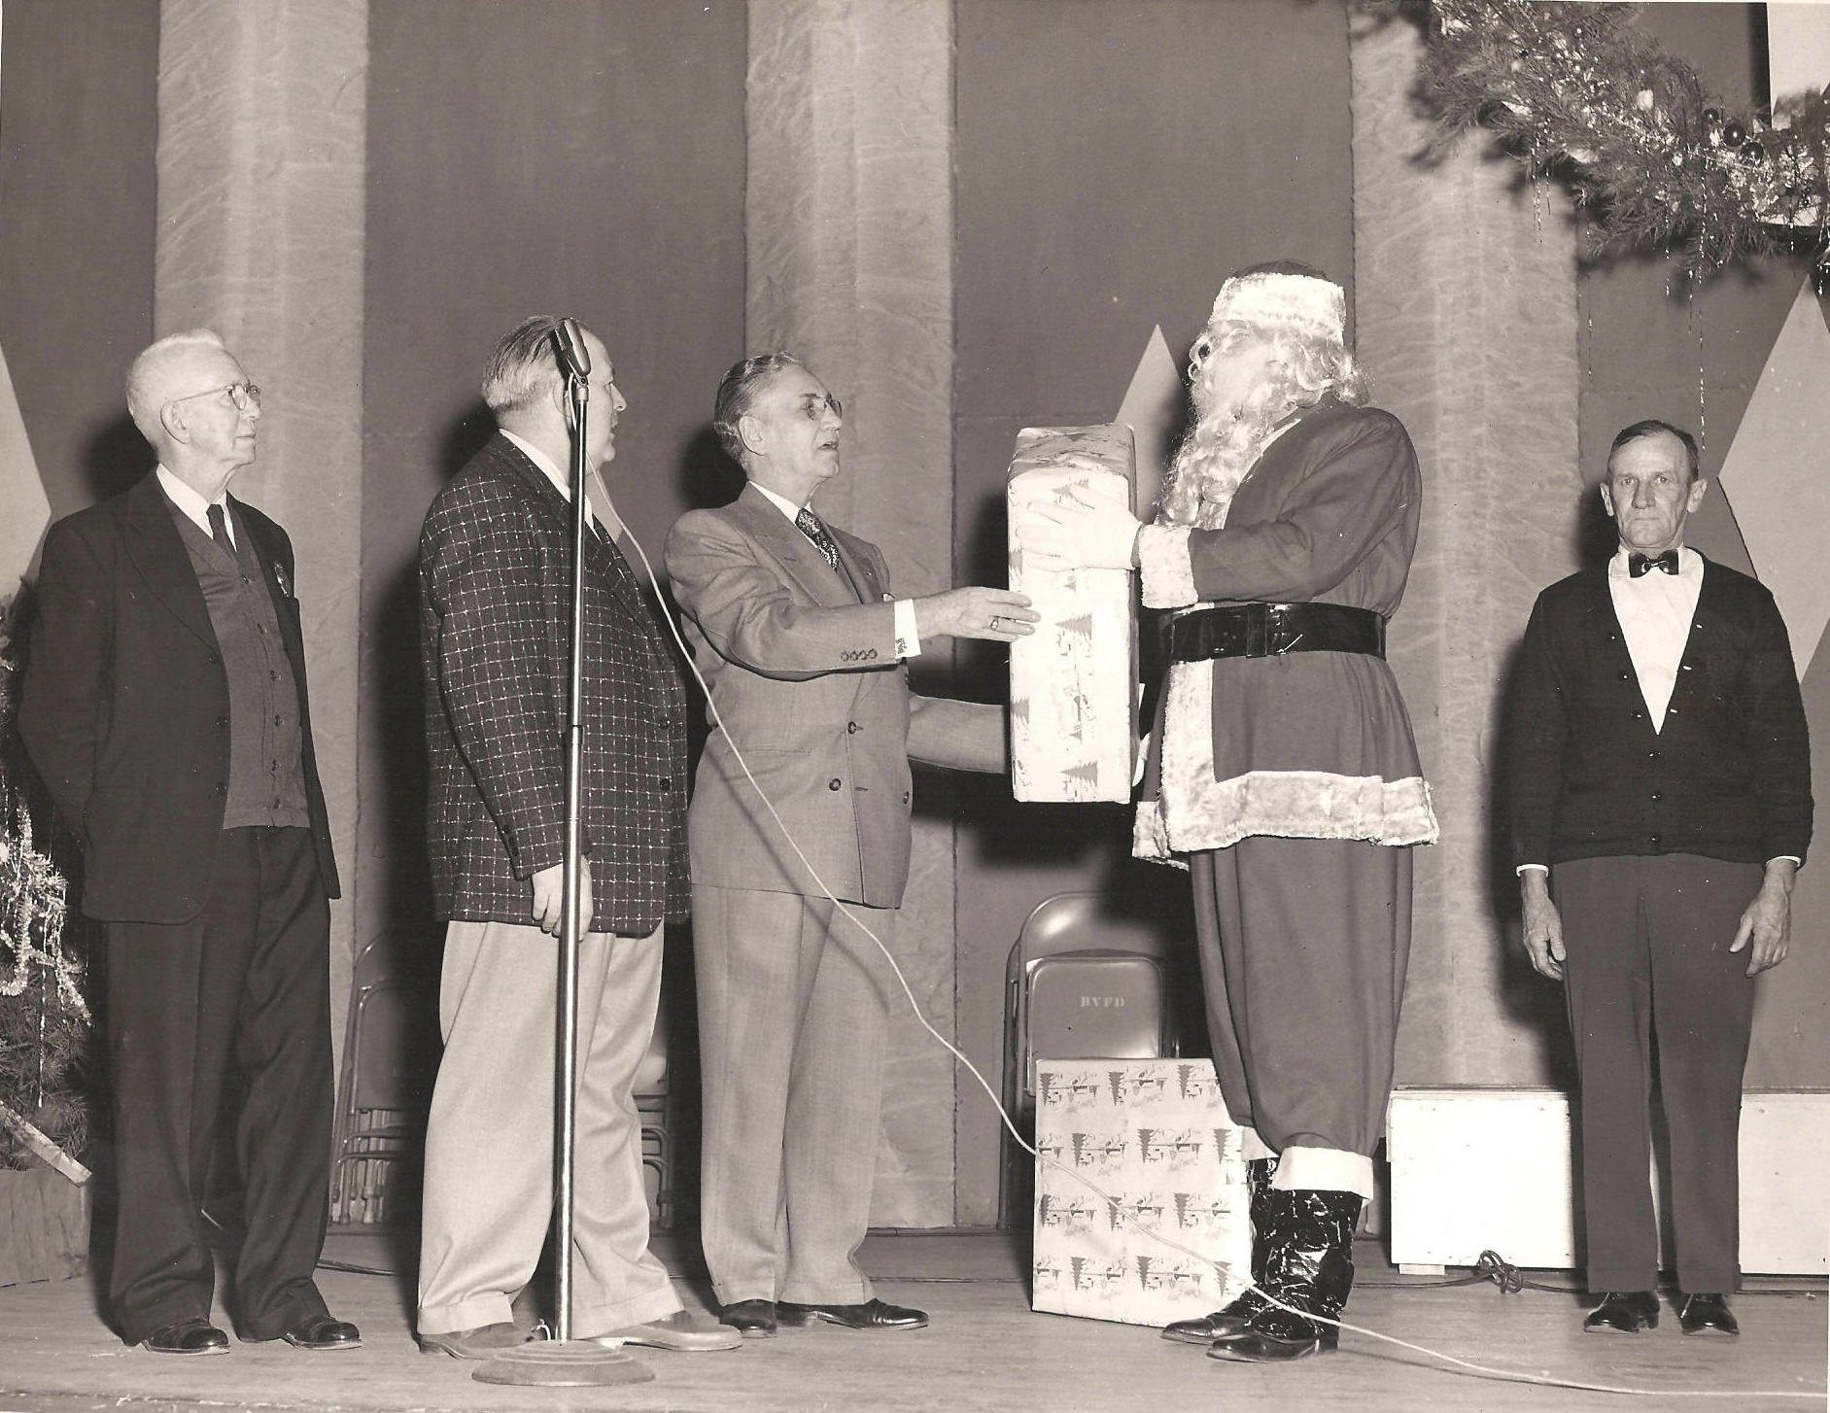
Charlie Smith,Sonny, Mayor Cummings, Ed Shipley as Santa, Walter about 1955 ?
Notes:
L/R W. Charlie Smith, Sonny Cannon, James Cummings, Santa Ed Shipley, Walter S Rice Engineer the years is about 1955 on the stage
of the fire hall on Potomac Street.

Slide 74
1955
This year a new bridge is being built to linking Brunswick with the state of Virginia; this will make it possible for the fire company to respond to Virginia without a wait for the B&O Railroad trains passing. The new bridge will pass over Potomac Street and the B&O Railroad.
**********
A letter is read from James Main pertaining to organizing a rescue squad the letter was tabled until later when Mr. Main could explain in more detail.
******
President H.E.Nicholson
Vice President Paul Tritapoe
Financial Secretary Richard Snoots
Secretary Charles Virts
Treasurer Floyd Strickler
Chief 5 H.E. Sonny Cannon

Slide 75
1956
President H.E.Nicholson
Vice President Paul Tritapoe
Financial Secretary Russell McMurry
Secretary Lyman Crawford/ Charles Virts
Treasurer Floyd Strickler
Chief 5 H.E. Sonny Cannon
******
June 6th 1956 check made to Litten Chevrolet for the purchase of a new Chevy Four Door Cab Fire Truck.

Slide 76
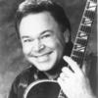
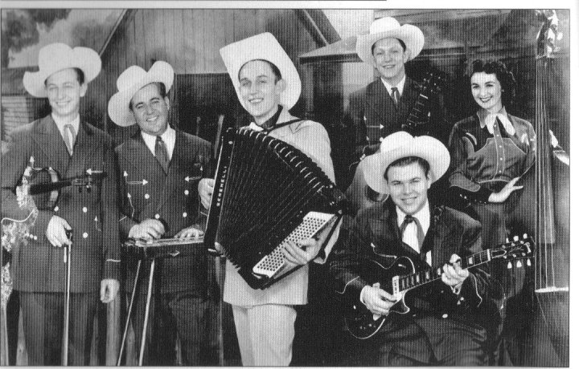
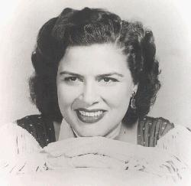
February 6, 1957
New Chevrolet pumper engine is put in to service. This pumper was purchased with funds received from fundraisers that included shows and dances provided by JIMMY DEAN, and The Texas Wildcats along with PATSY CLINE, ROY CLARK, BUCK RINE,BILLY GRAMMER, SMITTY ERWIN, GEORGE HAMILTON 4th and many more well known country and western stars
Jimmy Dean and The Texas Wildcats
Roy Clark Patsy Cline

Slide 77
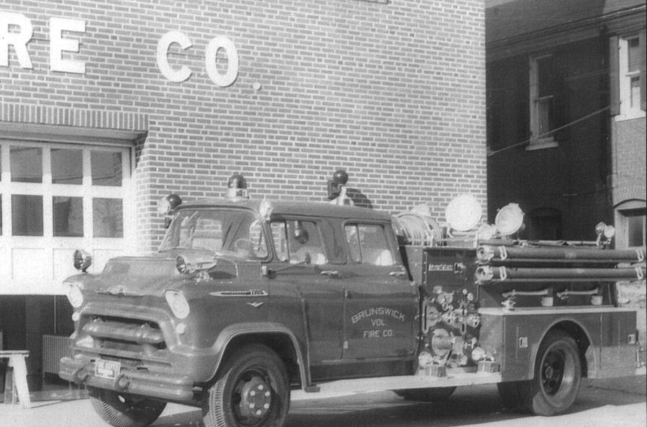
Brunswick’s New 1956 Fire Truck
Put in service Feb 6th 1957

Slide 78
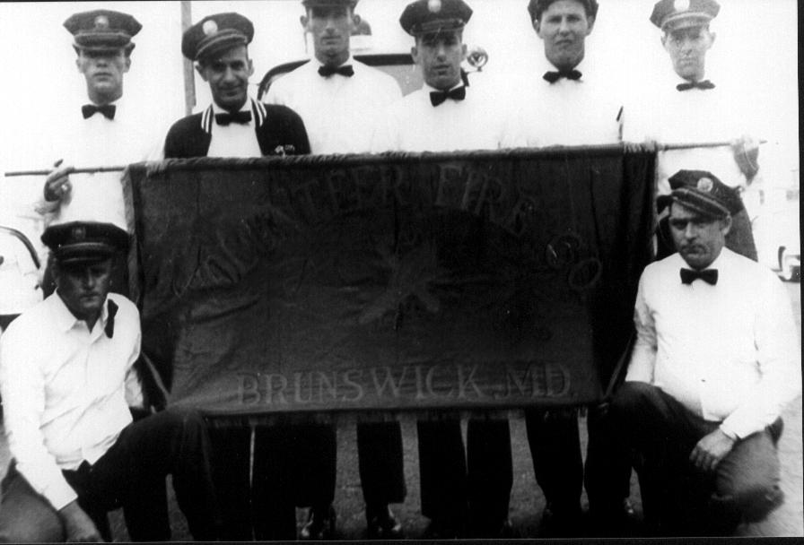
Member on the way to Ocean City convention showing off new Chevy Fire Truck. 1957
Notes:
Back row L/R Jim Dixon, Frank Migleo, Doug Fry, Clare Ebersole, Web Bennett, Ham Hahn
Front L/R Pete Virts, Bud Harrison

Slide 79
May 1958
May 20th of this year Capital Airlines and U.S. Military airplanes hit in mid air and crash on the O.C. Smith farm off Point of Rocks road near Brunswick, Maryland. Four crew, seven occupants perished. Brunswick Volunteer Fire Company responded.
*****
Milt Grant and his sock hop come to the fire company for the first dance this year.
******
Brunswick sells 1936 Ford fire truck to Pleasant Valley Fire Company.

Slide 80
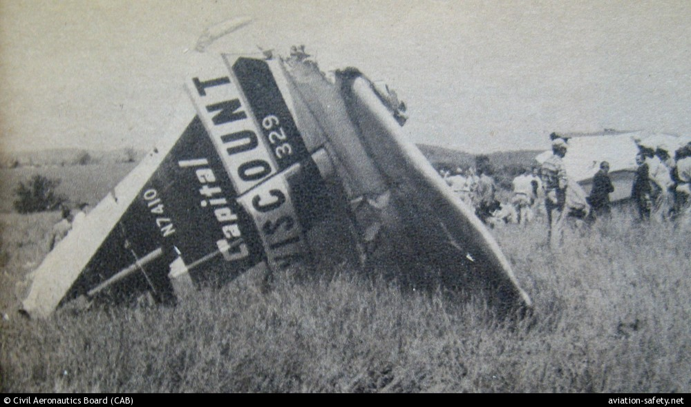
May 20th 1958 tail section of Capital Airline mid air collision
Notes:
Photo taken from news paper in Frederick.

Slide 81
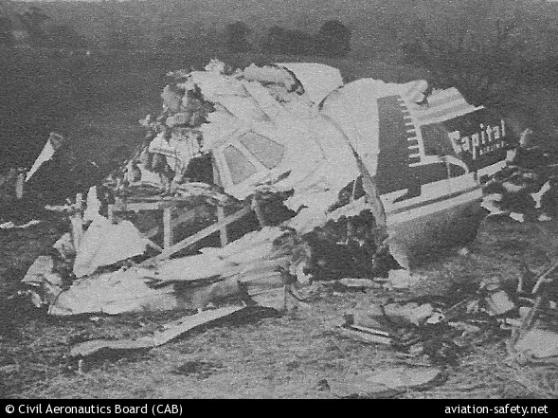
Nose section of the Capital Airliner

Slide 82
Officers 1958
President Paul Tritapoe
Vice President Floyd Strickler
Financial Secretary Russell McMurry
Secretary Charles Virts
Treasure Clair Ebersole
Chief 5 H.E. Sonny Cannon

Slide 83
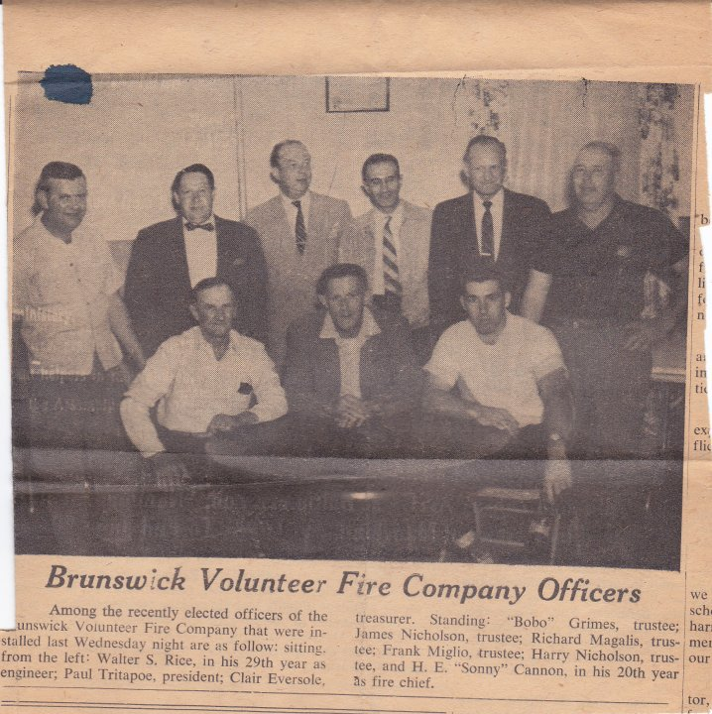
1958 Election of Officers

Slide 84
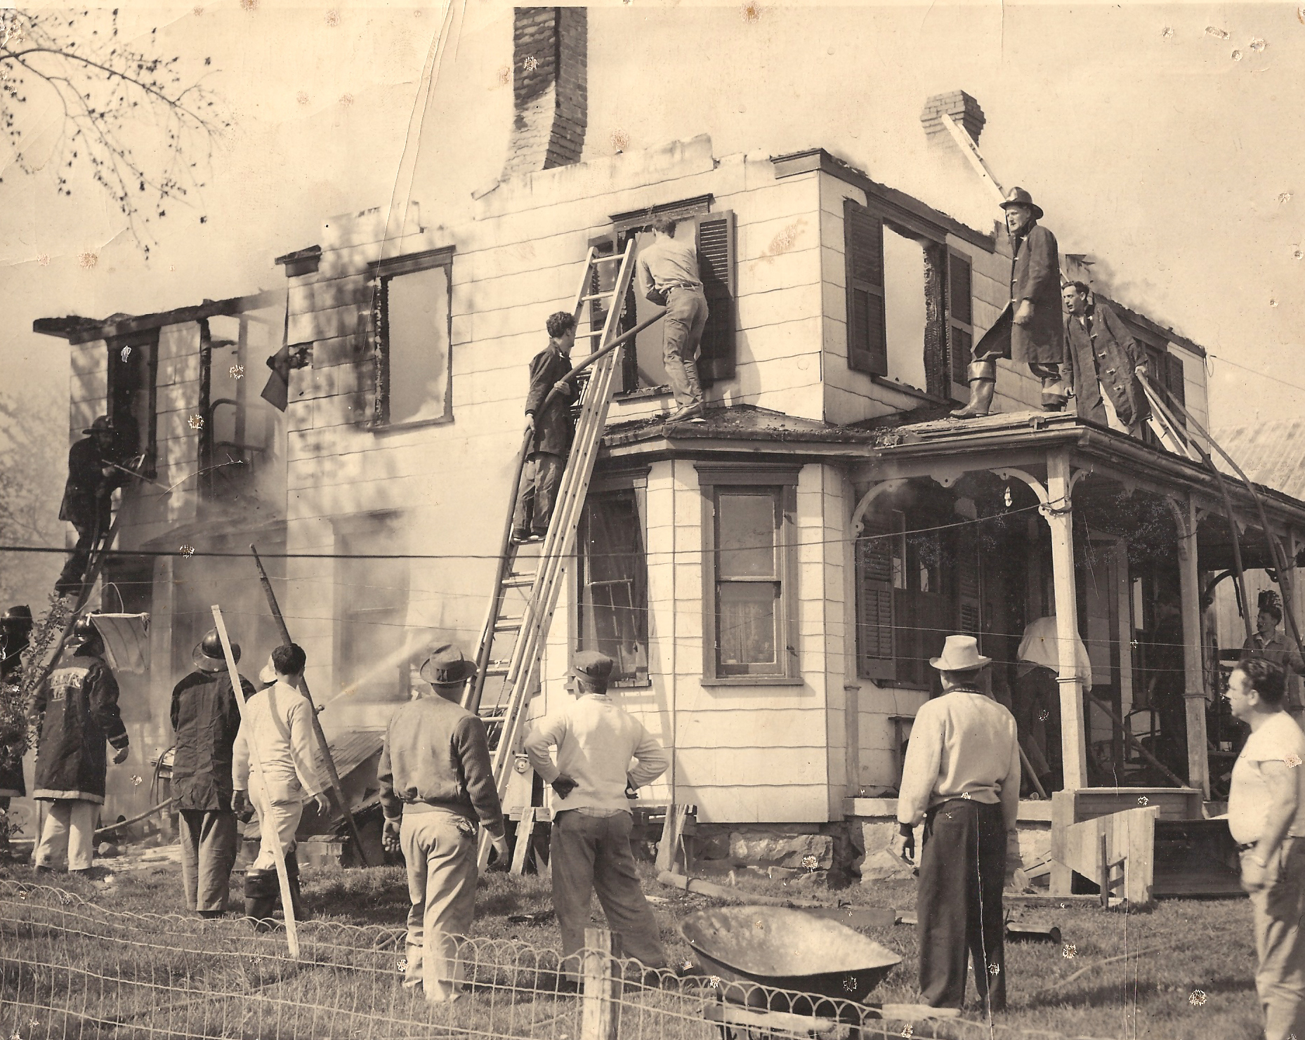
About 1958
Notes:
On the ladder is Jim Dixon next to him on the roof Davy Taulton. On the porch roof is Paul Tritapoe and Much Hahn.
On the ground L/R without gear is John Moyers, Sonny Cannon, Sam Axline and unknown, Poon Lewis.

Slide 85
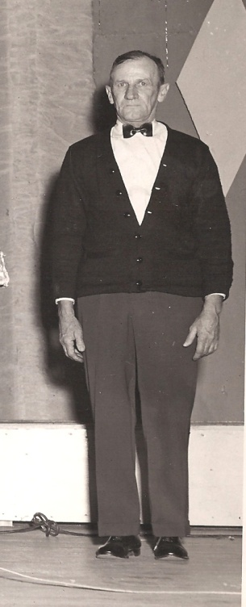
1959
Walter S. Rice the companies paid driver is in the hospital. Walter has many years of devoted service to the company. Walter started his employment about 1937. Walter is a live in driver.
President Charles Virts
Vice President Floyd Strickler
Secretary Richard Snoots Walter
Secretary Russell McMurry Rice
Treasure Frank Miglio
Chief 5 H.E. Sonny Cannon

Slide 86
Officers 1960
President Charles S. Virts
Vice President Floyd Strickler
Financial Secretary Richard Snoots
Secretary Russell McMurry
Treasurer Frank Miglio
Chief 5 H.E. Sonny Cannon
Trustee are
Harwood Watson, Harry Nicholson Sr.
Calvin A. Grams, Benny L Harsh and Richard Maglis

Slide 87
1960
Frederick County Fireman Convention is held in Brunswick the week of July 11th thru 16th. Brunswick member Paul L Tritapoe is President of the Frederick County Volunteer Association.

Slide 88
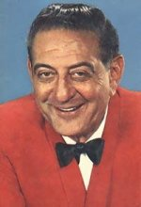
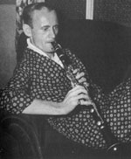
1960
Guy Lumbardo band comes to the fire company and a well attended dance was held for the public.
******
Sammy Kay’s Orchestra comes to the fire company this year on Nov 25th.
Guy Lambardo Sammy Kay

Slide 89
1961
A new base station radio is installed at the fire hall the total cost is $1365.00.
******
The Harry James band comes to the fire company for a dance.
********
President Charles Virts
Vice President Harwood Watson
Financial Secretary Robert Caniford
Secretary Harry Nicholson
Treasurer Richard Snoots
Chief 5 H.E. Sonny Cannon

Slide 90
Officers 1962
President Charles Virts
Vice President Harwood Watson
Financial Secretary Robert Caniford
Secretary Harry Nicholson
Treasurer
Chief 5 H.E. Sonny Cannon

Slide 91
1962
Guy Lombardo is back at the fire company on April 13th.
*****
The new building for the Brunswick Volunteer
Ambulance Company is dedicated on Sunday Feb 25^{th..} The Fire Company takes part in the dedication.

Slide 92
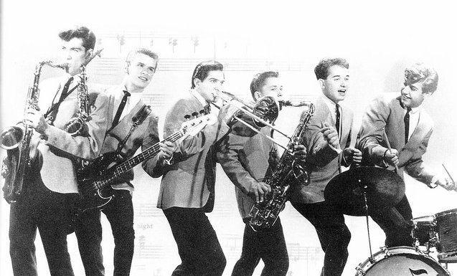
1963
In the 60’s came a local Band who made it very BIG in the Area and appeared at the Fire Hall
Damion and The Classics

Slide 93
1963
President Harwood Watson
Vice President Floyd Strickler resigned
H.E. Nicholson is
appointed
Financial Secretary Robert Caniford
Secretary Tom Watson appointed to
replace Nicholson
Treasurer Lenwood Moss
Chief 5 H.E. Sonny Cannon

Slide 94
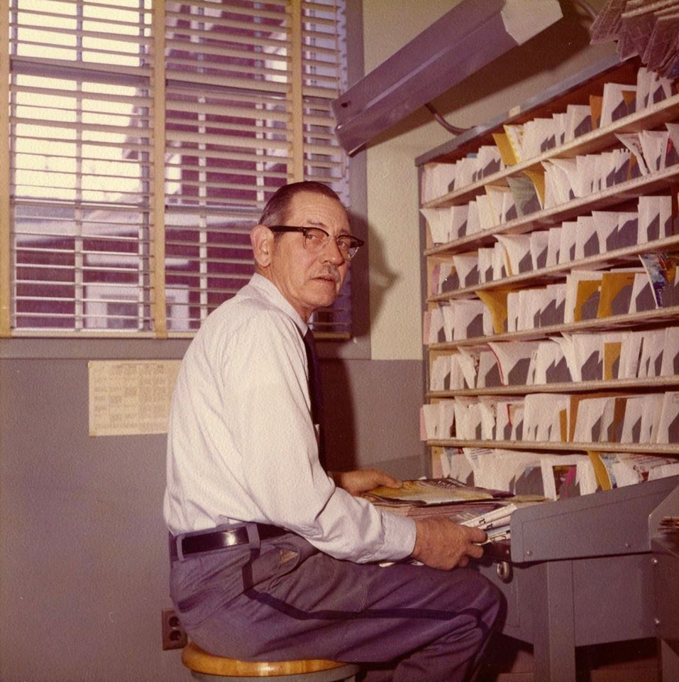
Passed President Harwood Watson

Slide 95
1964
President Harwood Watson
V President Gary Cooper resigned Jess
Orndoff appointed
Secretary Tom Watson
Treasurer Floyd Strickler
Financial Secretary Robert Caniford
Chief H.E. Sonny Cannon

Slide 96
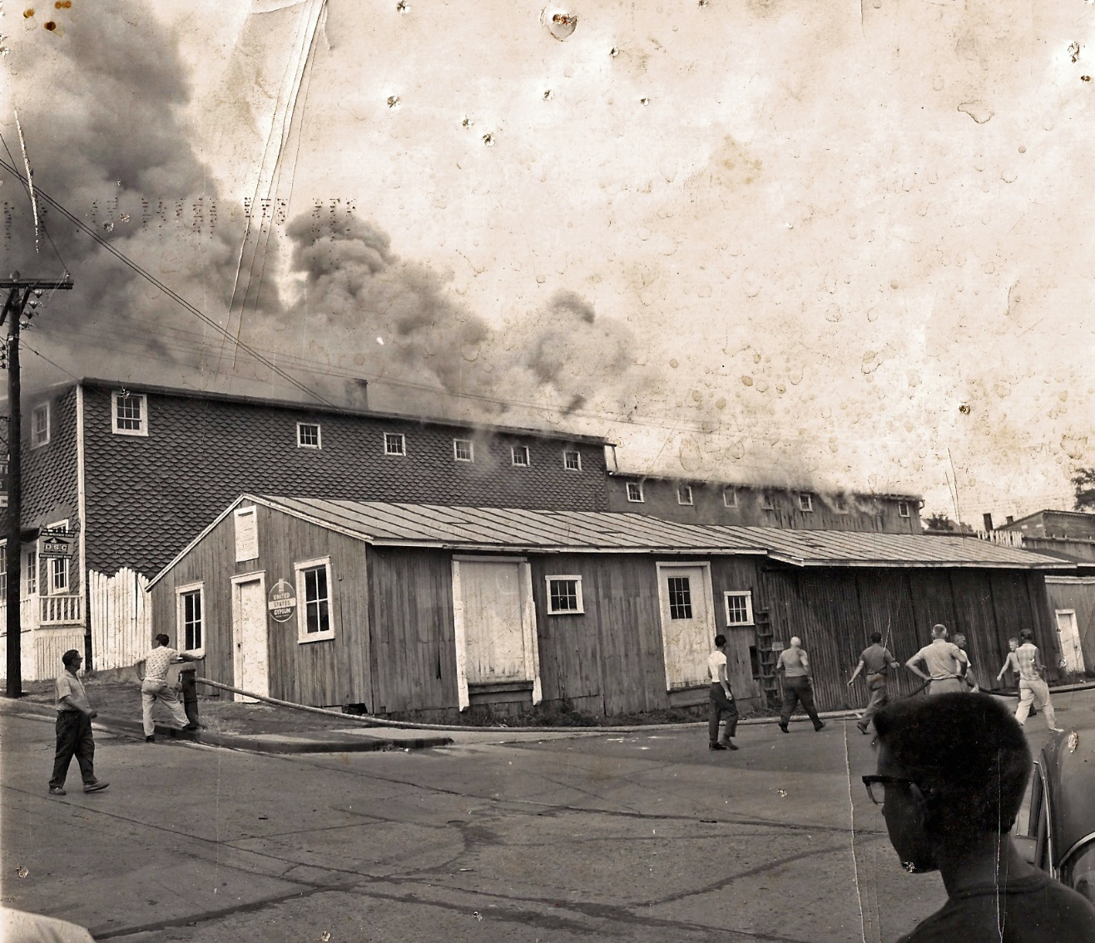
J P Karns 24th July 1963
Notes:
L/R Sid Bennet walking, Jim Dixon on the hydrant, unknow, Sonny Cannon running.

Slide 97
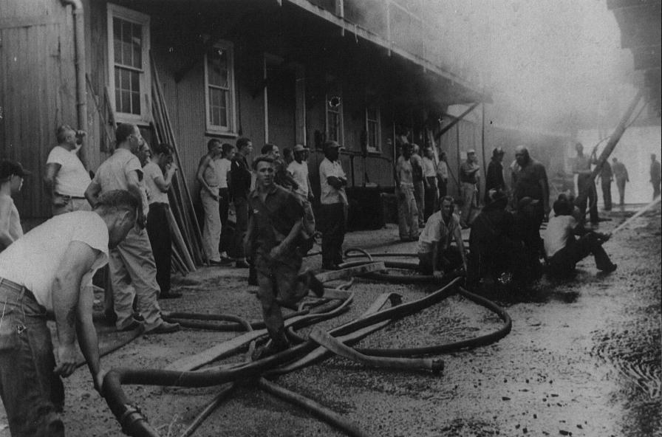
July 24 1963 Fire guts J P Karns lumber Company
Notes:
Harvey Snoots in the for ground running. Sonny Cannon standing in the mist of firefighters kneeling.

Slide 98
1965
Motion is made and carried to have bells hooked up to the telephones of the extra engineers, which would ring at their homes. The phone would be rung from the fire hall whenever there is a fire.
The phone company will install these bells in the homes of Thomas Watson, Bob Caniford, Donald Smith and Pete Virts.
******
Warren Coventon band to be at Fire Company on Feb 6th and Guy Lombardo is to return on May 12^{th.} Fire Company buys lot in rear of company from Mrs. Wenner for $400.00 cash.

Slide 99
Officers 1965
President Harwood Watson
V President Jess Orndoff
Second Vice Harry Nicholson
Secretary Charles Virts
Treasurer Floyd Strickler
Financial Secretary Robert Caniford
Chief H.E. Sonny Cannon

Slide 100


1965
George Jones country western star, comes to Fire Company on Sept 10th for two shows
George Jones

Slide 101
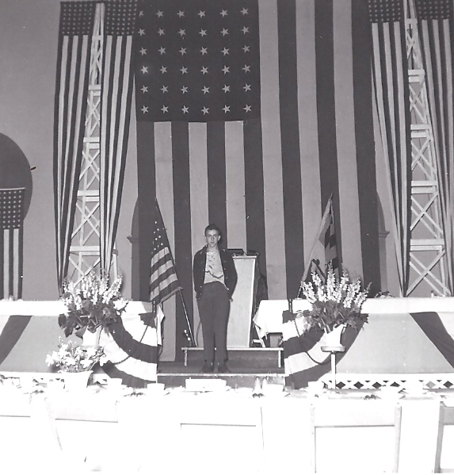
Harvey Snoots Past Mascot for many years

Slide 102
Officers For1966
President James Dixon
V President Donald Minnick
Second Vice Russell Eury
Secretary Charles Virts
Treasurer Floyd Strickler resigned
Richard Snoots appointed
Financial Secretary Robert Caniford
Chief 5 H.E. Sonny Cannon

Slide 103
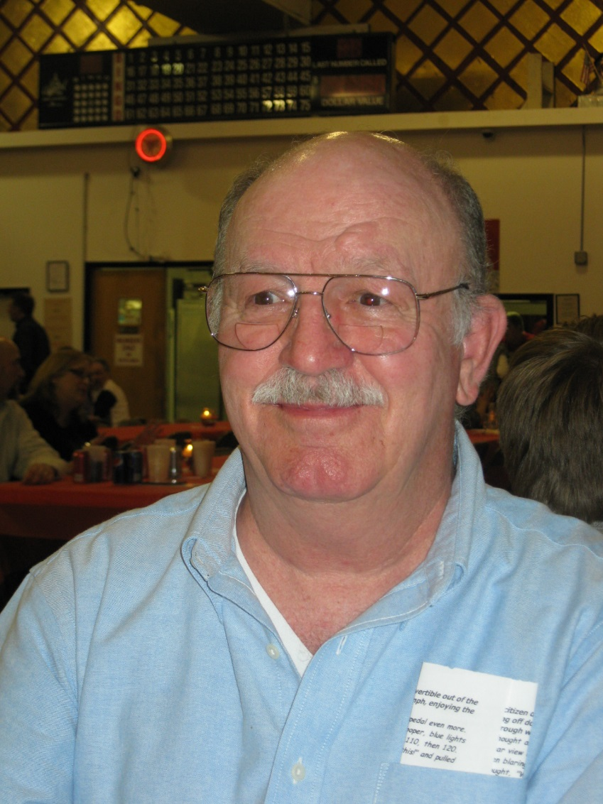
James M Dixon Past President 1966

Slide 104
Walter Sylvester Rice, Died
26 May 1966
After a long illness, Walter Sylvester Rice engineer driver, for the Brunswick Vol. Fire Company passed away 26 May, 1966.
Walter was born and raised in Hollywood, Maryland came to Brunswick to work on the railroad. Later becoming a full time paid driver for the fire company. He leaves a brother Leroy Rice of Brunswick.
Burial will take place 27 May 1966, at the Loudon Park Cemetery, Baltimore, Maryland

Slide 105
26 May1966 Walter S Rice Passes away

Slide 106
1967
President H.E. Nicholson Sr.
1st Vice President Robert (Chick) Moyers
2nd V President George Thomas
Secretary Charles R Virts
Fin Secretary Robert Caniford
Treasurer Richard Snoots
Chief H.E. Cannon

Slide 107

Harry E Nicholson Sr.
Past President

Slide 108
1968
President H.E. Nicholson Sr.
1st Vice President George Thomas
2nd V President Russell Eury
Secretary Charles R Virts
Fin Secretary William F Woulard
Treasurer Robert Caniford
Chief 5 H.E. Sonny Cannon

Slide 109
Officers 1969
President H.E. Nicholson Sr.
1st Vice President George Thomas
2nd V President L.S. Lucas
Secretary Charles. R. Virts
Fin Secretary William.F. Woulard
Treasurer Robert Caniford
Chief 5 H.E. Cannon

Slide 110
1969
June 2nd motion made to sell 1922 American LaFrance to anyone who would purchase for $1000 dollars. Motion carried and sold to Leonard King.
******
This year Guy Lombardo comes back to the Fire Company for a public dance.

Slide 111
1970 Officers
President Robert Wheeler
1st V President Robert Minnick
2nd V President Leonard S Lucas
Secretary Charles R Virts
Fin. Secretary William F Woulard
Treasurer Robert Caniford
Chief 5 Harvey E Cannon

Slide 112
Officers 1971
President Robert Wheeler
2nd V President Leonard S Lucas
Secretary Charles R Virts
Fin. Secretary William F Woulard
Treasurer Robert Caniford
Chief 5 Harvey E Cannon

Slide 113

Samuel Steven Kidwiler
March 28, 1971 the Company lost a Volunteer, Samuel (Steve) Kidwiler who fell from the rear of a fire truck returning from a fire. Steven will be missed by his follow firefighters and the community.
Notes:
Leather strap for which Steve was holding snapped causing him to fall from the truck. This accident happened just west of New Addition on Knoxville Road, Knoxville, Maryland.

Slide 114
1972 Officers
President Leonard Lucas
V President C.A. Webber
2nd V President Charles Leopold
Secretary Charles. R. Virts
Ass’t Secretary William F. Woulard
Treasurer Robert Caniford
Chief 5 H.E. Sonny Cannon

Slide 115
1972
The Fire Company has a major fire on the south side of the B&O Railroad. The Old Brunswick Mill burns to the ground.

Slide 116

Old Brunswick Mill

Slide 117
1973
President Leonard S. Lucas
1st V President James Fawley
2nd V President Charles Leopold
Secretary Scott Stauffer
Treasurer Robert Caniford
Fin Secretary William Woulard
Chief 5 H.E. Cannon

Slide 118
1974 Officers
President Leonard S. Lucas
1st V President James Fawley
2nd V President Charles Leopold
Secretary Scott Stauffer
Treasurer Robert Caniford
Fin Secretary William Woulard
Chief 5 H.E. Cannon

Slide 119
1974
The company takes delivery of a new 1973 GMC Oren pumper. It carries 750 gallons of water and has a 750 GPM pump. This unit was placed into service as Engine 51.
*******
The company takes delivery of its new 1973 Chevrolet Van. The unit will be used to carry extra equipment that is needed at a fire scene. The unit was placed into service as squad 5.

Slide 120

1973 GMC Pumper with Oren Pump

Slide 121

1973 Chev Squad 5 Van

Slide 122

1973 GMC Pumper with a Oren Pump

Slide 123

BVFD Squad 5

Slide 124
Officers 1977
President Harvey E Cannon
1st V President Harvey M Jones resigned
Gary Cooper appointed
2nd V President Gary Cooper resigned
Tony Webber appointed
Secretary James E Holder Jr.
Fin Secretary William Woulard
Chief 5 Russell Eury

Slide 125

H.E.Sonny Cannon’s Retirement Party after 37 years as Chief 5
Left to Right
Unknown person
Sonny Cannon Chiefs
Judge William Wenner
George Bennett

Slide 126
1977
Bob Crosby band comes to the fire company on Oct 30, 1977 for a public dance. Dance is sold out.

Slide 127
1978
The company receives a 4x4 army jeep from the Civil Defense and turns the truck into the company’s first brush unit. The truck carries 208 gallon of water and has a 250 GPM pump. This unit was placed into service as Brush 55
Note:
As of 2006 this unit is still in service and serves the fire company very well on mountain and brush fires.

Slide 128

Brush 55 4x4 Jeep

Slide 129
1978 Officers
President Delmar Brown
1st V President William Martin
2nd V President Alderidge Longerbeam
Secretary Richard Campbell
Treasurer Tony Webber
Fin Secretary William Cook
Chief 5 Russell Eury

Slide 130

Acquired 1978

Slide 131

1978 Chief 5 Russell Eury
Notes:
Russell Eury a life member very devoted to the company.

Slide 132
1979 Officers
President Delmar Brown
1st V President William Martin
2nd V President Harvey Cannon
Secretary
Treasurer Tony Webber
Secretary Ralph Welsh is Appointed on 14th Feb of this year.
Fin Secretary William Cook
Chief 5 Rick Campbell

Slide 133
February 16th 1979
The company has a major fire, directly across from the fire house, the old Hovermale property burns to the ground. This property housed the Shoe repair shop, the Goodwill store and a Furniture refinishing business (where the fire started) and apartments on second floor.

Slide 134

1979

Slide 135

February 16th 1979

Slide 136
1980 Officers
President Delmar Brown
1st V President Jay Main
2nd V President Ronald Lowe
Fin Secretary Bill Cook
Secretary Thomas Dawson
Treasurer Tony Webber
Chief 5 Richard Campbell

Slide 137

Company 5 First Patch
Notes:
The first shoulder patch for the BVFD.

Slide 138
Nov 1980
Brunswick looses Historical Land Mark as a multi alarm fire destroys the B&O YMCA. This very large building did not burn completely down although it had to be demolished later.
******
At the annual membership banquet this year Chief Campbell stated with the help of the Jefferson and Lovettsville Volunteer Fire Companies he had over a million dollars in fire losses. This statement was a fact but we all know this was Chief Campbell’s’ loss. Lovettsville and Jefferson have for many years been very helpful to the Brunswick Volunteer Fire Company and we are very grateful for their help in protecting the town of Brunswick.

Slide 139

Brunswick’s YMCA

Slide 140

The Night of the Fire

Slide 141

The Day After the Fire
Notes:
Day after the YMCA fire. Rear view of the YMCA building

Slide 142
August 6th 1980
Building committee talks about purchase of a lot for a new building. The Brunswick Volunteer Ambulance Company is asked if they would like to join this effort, but they declined the offer.
******
Company has a major crack in the front of the building. Yingling Construction Co. was low bid on repairing the crack in the front of the building at a cost of $9200.00.

Slide 143
1981
The company places into service a New 1980 Ford class “A” pumper with Caterpillar Diesel engine, a 1000 GPM pump and Deluge Gun.
********
Purchase of lots on West Brunswick Street is done this year with hopes of building a new fire station.
********
Officers 1981
President Richard Campbell
1st V President William Sauser
2nd V president Jim Dixon
Secretary Ralph Welsh
Fin Secretary William Cook
Treasurer Tony Webber
Chief 5 Gary Eury

Slide 144

1980 Ford Class “A”

Slide 145
1982 Officers
President Charles Leopold
1st V President Rick Campbell
2nd V President William Nichols
Treasurer Tony Webber
Secretary Lewis Dominick
Fin Secretary William Sauser
Chief 5 Gary Eury

Slide 146
1982
The company purchases a 1960 Pirsch 100 foot. Arial Ladder Truck for $100.00 from Washington, D.C. This truck will require 2 drivers, one on the front end and one on the rear end. This unit was placed into service as Truck 5.
******
Charlie Smith a member was responsible for making the deal with the Washington, D.C. fire service.
******
The company has a new metal building erected on our carnival grounds, west of the Acme Market to house the Ladder truck. Total cost of building is $35,000.

Slide 147

1960 Pirsch 100 foot arial Ladder. Company 5’s First Ladder
Notes:
Brunswick’s first ladder truck, thanks in most part to Charlie Smith who went to Washington DC and worked the deal to have it donated along with many extra parts

Slide 148

Picture taken about 1982
Notes:
Driver Bob Caniford Sonny Cannon
Behind Sonny is Gary Eury, behind Bob Canoford is Charlie Smith
On the rear R/L Jim Dixon and Dave Taulton

Slide 149

1983 Line Officers
Notes:
L/R Charlie E Smith, Bill Sauser, Gary Eury, Slim Longerbeam, Rick Campbell, Dave Taulton and Dwight Hoffman.

Slide 150


19th Dec 1982
On 19th Dec 1982, 1st Assistant Chief Dave Taulton died in the line of duty. The company and community mourn the death of this dedicated volunteer.
Notes:
Dave Taulton was a life member very devoted to the fire company for many years. What a friend he was to everyone.

Slide 151

Funeral of Dave Taulton1982

Slide 152
1983 Officers
President Ronald Lowe
1st Vice President Charles Leopold
2nd Vice President Dennis Moore
Treasurer Tony Webber
Fin Secretary Rick Campbell
Secretary Lew Dominick
Chief 5 Gary Eury
*******
Motion made and passed to have a plaque made in memory of Dave Taulton, and to have the name of the Top Responder of each year inscribed on this plaque with trophy going to that individual. This became known as the Dave Taulton Award.

Slide 153

1983 the Fire Company Cadets is formed

Slide 154
1984 Officers
President Jim Dixon
1st Vice President Charles Leopold
2nd Vice President Dwight Hoffman
Treasurer Tony Webber
Fin Secretary Nancy Nichols
Secretary Anna Lowe
Chief 5 Gary Eury

Slide 155
1984
Company sales 1953 American La France truck for $1000.
********
The town of Brunswick purchases a 1984 International Tanker from 4 Guys for the company. It carries 1800 gallon of water and has a 500 GPM pump. The color of the tanker is red and white. Purchase price of this unit is $60,000 the unit is placed into service as tanker 5.
******
Engine 52 which was a 1956 Chevrolet is sold for $500.00.
******
Contract signed for Harvey and the Hubcap 50/60’s music March 10th 1984. Very large turnout for this band.

Slide 156

1984 International Tanker

Slide 157
1985
President Charles W. Leopold Jr.
Chief 5 Gary Eury

Slide 158
1986
President Charles Smith
1st Vice President Bo Hane
2nd Vice President Bob Eury
Treasurer Tony Webber
Fin Secretary Winnie Hollar
Secretary Charlie Dalton
Chief 5 Gary Eury
Trustee - Nancy Nichols, Roy Lipscomb, Ken Fauble ,Mark New and Russell Eury

Slide 159

Charles Smith Past President 1986

Slide 160
Oct 13th 1987
On October 13th Past Fire Chief (Sonny) Harvey E. Cannon dies, the company and community lost a lifelong devoted volunteer. Sonny was Chief of the Brunswick Volunteer Fire Company for 37 years from 1938 thru 1976.
Sonny was responsible for many of the fundraiser at the fire company over the years we had entertainers’ like Jimmy Dean, Patsy Cline, Roy Clark, Billy Grammer, Buck Rine, George Jones just to name a few.

Slide 161
1987
This year is the first year for the Frog Eye Mud Bog being held on the Albert Roelkey Farm off of Route 67 on Frog Eye Road, Washington County, Maryland. The Mud Bog came to life at the Himes country store. A discussion between Jim Dixon and store owner Gary Himes. The day of the Mud Bog started out with heavy rain in the morning and ending up to be a very nice day, with a lot of trucks and well attended by the public.
********
President Carroll Webber
1st Vice Charlie Leopold
2nd Vice Bobby Eury
Secretary Larry Shew
Treasurer Dave Young
Chief 5 Gary Eury

Slide 162
1988 Officers
President Carroll Webber
1st Vice Charles Dalton
2nd Vice Charlie Leopold
Secretary Bill Curry
Treasurer Dave Young
Chief 5 William Sauser
Trustees
Roy Lipscomb Russell Brightwell
Mark New Arnold Martin
Russell Eury

Slide 163

1988 Top Man Hours

Slide 164

William Bill Sauser
Past Chief
William (Bill) Sauser served as our Lawyer, Historian and Fire Chief and other offices.

Slide 165
1988
H.E. Sonny Cannon is placed into the Maryland State Firemen’s Associations Hall of fame.
*******
The company places an order for a New Class “A” pumper, a Pierce Dash. The truck is to be built to the specification of the pumper committee which consisted of 9 company members.

Slide 166

1988 Clinton “Bud” Harrison Life Member passed away this year.
Notes:
Clinton “Bud” Harrison a life member the fire company. On Saturday nights when there was a dance you could find Bud with his whistle on the stag calling out the pall jones. Bud was a life member.

Slide 167
1988
The company purchases a 1971 Seagrave straight chassis 100 foot Aerial Ladder Truck from the Middle River Volunteer Fire Company in Baltimore County to replace the old truck 5 ladder, damaged in an accident. The truck is purchased for $58,000.00 it is placed into service as Truck #5

Slide 168

1971 Seagrave Ladder
Notes:
This truck was put in service to replace the old tiller ladder that was damaged beyond repair.

Slide 169
1989
The company takes delivery of its New Pierce Dash Class “A” pumper, it carries 750 gallon of water and has a 1000 GPM pump. The color of this pumper is red and white. Purchase price of the unit is $145,000.00 and an additional $20,000.00 was spent on new equipment for this unit. The New pumper was put into service as Engine 52
***********
The company also purchases a 1979 Chevrolet Malibu, from the Brunswick Police Department. Invested $1000.00 in the vehicle placed it into service as a Chief’s car. The car is red in color.
**********
In November a Hazmat drill was held in the CXS Railroad yard. There were 9 fire/rescue companies and the Public Safety Division that participated in the drill with over 100 volunteers participating. The drill consisted of a tank car leaking a dangerous chemical. Although it was not an actual incident everything was handled as through it was, it was a great learning experience for all.
**********
President Carroll Webber
Chief 5 Roy Lipscomb

Slide 170

1989 Pierce Dash Pumper
Notes:
This engine would later become engine #51 being replaced by a newer rescue engine #52.

Slide 171

Roy Lipscomb Chief 5, 1989

Slide 172
1989
A plaque in Memory of “Harvey E. Cannon “Sonny” who was Chief for 37 years, was erected on the outside front of the Potomac Street Fire House at a County meeting held at Brunswick Volunteer Fire Company, in September.
This plaque is now at the new station on display

Slide 173
1990
The Company purchased a 1978 Pierce Dodge mini pumper from Glennrock Hose and Ladder Company, in Pennsylvania purchase price $18000.00. The unit carries 250 gallon of water and pumps 400 GPM. Is a 4X4 wheel drive unit. Unit was painted red and white and placed into service as brush #56.
Engine 53 is painted red and white, all vehicles that are not red and white at this time will eventually be repainted red and white and the lime yellow being phased out.
President Carroll (Tony) Webber
Vice President Charles Leopold
2nd Vice President Robert Fleming
Secretary Karee Danner
Treasurer David Young
Fin Secretary Robert Fleming
Chief 5 Roy Lipscomb
Trustee
Jim Dixon Bud Harrison Russell Eury Bill Curry Raymond Cooper

Slide 174

1990 Officers

Slide 175

1978 Pierce Dodge Brush 55

Slide 176
1991 Officers
President Robert Foreback
1st V President Charles Leopold
2nd V President Dwight Hoffman
Fin Secretary Robert Fleming
Treasurer David Young
Secretary Tony Webber
Chief 5 Roy Lispcomb
Trustees
Jim Dixon Russell Eury Bryan Green

Slide 177

Robert Foreback President 1991

Slide 178
1994
President Jim Dixon
1st Vice President R.C.Foreback
2nd Vice President Charles Leopold
Secretary Troy Lloyd
Fin Secretary Bobby Fleming
Treasurer Tony Webber
Chief 5 Roy Lipscomb
This year there was a very large fire in down town Brunswick. The fire started in the rear of formal Darr’s Tavern (Later known as The Crabhouse) and spread to two other building formally Coffman Dept store and on the corner Triangle Food Services (Later known as Katz’s jewelry store.)
The fire was the work of an arsonist, investigation found the owner of the crabhouse was responsible.
The second floor of all these buildings was apartments with families living in them, no injuries from the fire was reported.

Slide 179




Crab House Fire 1994

Slide 180
1995
President Charles Leopold
1st Vice President R.C.Foreback
2nd Vice President Dave Young
Secretary Troy Lloyd
Fin Secretary Kevin Myers
Treasurer Bobby Fleming
Chief 5 Roy Lipscomb

Slide 181

Charles Leopole President 1995

Slide 182

This Year 1995 we placed in service a 1995 Seagrave 105 foot Arial Ladder Truck

Slide 183

October 24. 1996

Slide 184
1998 Officers
President George Clary Jr.
Vice President RC Foreback
2nd Vice President Ronald Lowe
Treasure Robert Fleming
Fin Secretary Kevin Myers
Secretary Cheryl Curry
Chief 5 Roy Lipscomb
Trustees ****** Jim Dixon
George Houser Tony Webber
Mike Fauble Rick Pierce
Honorary Trustee Russell Eury

Slide 185
1999
President Charles Leopold
Chief 5 Roy Lipscomb
This year Company 5 purchased a new chief vehicle a 1999 Ford Explore.

Slide 186

1999 Ford Chiefs Car

Slide 187
2000 Officers
PRESIDENT Charles Leopold
Vice President Todd Webber
Past President George Clary
Treasurer Harry Elliot
Fin Secretary Jim Dixon
Secretary David Young
Chief 5 Roy Lipscomb
Trustees
Tony Webber Ronald Lowe Debbie Fauble
Kenneth Fauble Jeff Simons

Slide 188
2001 Officers
President Charles Leopold
Vice President Todd Webber
Treasurer Harry Elliot
Secretary Lyndi Carter D’Amico
Fin Secretary Jim Dixon
Chief 5 Roy Lipscomb

Slide 189
2002
26 Members are fitted for Class A uniforms.
Engine 51 has Rescue Equipment installed and all drivers are trained on the equipment.
President George Clary
Vice President Tony Webber
Treasurer Harry Elliott
Fin Secretary Dave Young
Secretary Lyndi Carter D’Amico
Chief 5 Roy Lipscomb
Chief 5-1 Wade Watson
Chief 5-2 Todd Webber
Chief 5-3 Harry Elliott

Slide 190

George R Clary President 2002

Slide 191

Members in their new Class A uniforms 2002
Notes:
Front Keith Frye, Wade Watson, Jason Russel, Chief Roy Lipscomb,
Rear Ronald Lowe, Clarence, Mark Nickolson, Lance Carvalie ?? George Houser

Slide 192

BVFD members with their new class a uniforms
Notes:
Front L/R Hot Dog Webber, George Clary, Todd Webber, Mark Myers, George Houser.
2nd Row Kenny Lang, Roy Lipscomb, ??, Lawerance Pirece, Anthony Smothers, Dave Nalborczyk
Rear Courtney Nalborczyk, Jason Russell, Kenny Nicewarner

Slide 193
2003
President George Clary
V President Tony Webber
Treasurer Marilyn McKenzie
Fin Secretary Dave Young
Secretary Lyndi Carter D’Amico
Chief 5 Roy Lipscomb
Annual Gun Calendar is started this year with Brunswick, Wolfsville, Jefferson and Emmittsburg going together on this project. Later Wolfsville and Jefferson Droped out.
9/17/2003
Motion made to purchase the Old American LaFrance engine back from Leonard King and restore.

Slide 194
2004 Officers
President George Clary
V President Tony Webber
Treasurer Marilyn McKenzie
Fin Secretary Dave Young
Secretary Lyndi Carter D’Amico
Chief 5 Roy Lipscomb
Chief 5-1 Wade Watson
Chief 5-2 Todd Webber
Chief 5-3 George Houser

Slide 195
2004
Brunswick Volunteer Fire Company repurchased for the sum of $20,000 from Leonard King the 1922 American LaFrance pumper sold to Leonard King in 1969. This engine was the first motorized piece of equipment for the Brunswick Volunteer Fire Company. It is now going through the stages of being restored completely by Wade Watson and committee.
Wade has put his heart into the rehab of this antique and is doing a very good job.

Slide 196

1922 LaFrance

Slide 197

1922 LaFrance on its way home
Hot Dog Driving and Wade riding

Slide 198
2005 Officers
President George Clary
Vice President Tony Webber
Treasurer Marilyn McKenzie
Fin Secretary Dave Young
Secretary Lyndi Carter D’Amico
Chief 5 Roy Lipscomb

Slide 199
Sept 26th 2005
The Brunswick Volunteer Fire Company loses a very devoted volunteer in an accident. Past President and Life member. CHARLES LEOPOLD was killed while steel is being unloaded from the truck he was driving.
CHARLES for years in the past was very active in volunteering his time for fundraisers and other Fire company business. Charles was a guy who couldn’t say NO to the fire company.
Charlie also held other offices at the fire company.
Charlie will be missed by his fellow firefighters and
the community.

Slide 200
Born May 14 1942
Died Sept 26 2005
Charles W Leopold
Notes:
Charlie was a guy who could not say No to the fire company, what ever needed to be done he was there. He also had many friends

Slide 201


Slide 202
2006
President George Clary
V President Tony Webber
Treasurer Marilyn McKenzie
Secretary Lyndi Carter D’Amico
Fin Secretary Dave Young
Chief Roy Lipscomb
This year is the 19th annual Frog Eye Mud Bog

Slide 203
2007
President George Clary
V President Tony Webber
Treasurer Kevin Myers
Secretary Lyndi Carter D’Amico
Fin Secretary Dave Young
Chief Roy Lipscomb

Slide 204
August 2007
This year is the 20th annual Frog Eye
Mud Bog.

Slide 205

Past President
Carroll A Tony Webber
Tony was a Past President and Life Member. He also held other offices in the Fire Company. Tony was very active in the fire company even up until his passing.
He was a very devoted Volunteer until passing 9 Oct 2007
Notes:
I can’t say enough about Tony he was a great family man who loved to travel also loved the fire company.

Slide 206

2007, We Placed in service a 2007 Pierce Rescue Engine

Slide 207
2008
President George Clary
Vice President Tony Webber
Treasurer Kevin Myers
Secretary Lyndi Carter D’Amico
Fin Secretary Dave Young
Chief Roy Lipscomb

Slide 208

Gary Webb Bennett, A Life member with over 50 years of Volunteer service passed away this year. 2008
Notes:
Webb Bennett a life member, if you was a friend of Webb’s you was a friend for life.

Slide 209
2009
President GEORGE CLARY
V President Tony Webber *Deceased
V President Tom Watson
Treasurer Kevin Myers
Secretary Lyndi Carter D’Amico
Fin Secretary Dave Young
Chief 5 Roy Lipscomb

Slide 210

After a hard day of training at the training center about 2009
Notes:
Front Row. Lance Carvelli, Shane Manner
Rear L/R Jeff Simons, Shannon Esworthy, Mark Fauble, Keith Frye, Larance Pierce and Mark Nickolson

Slide 211
2010
President George Clary
V President Tom Watson
Secretary Lyndi D’Amico
Financial Sec David Young
Treasurer Kevin Myers
Chief Roy Lipscomb
Board of Directors
RC Foreback Clarence Webber Todd Webber
Jeff Simons Sandy White

Slide 212

Top Man Hours for 2010
Notes:
L/R George Clary, Jim Dixon, Roy Lipscomb, Dave Young, Clarence Webber, Lindy D’Amico, Todd Webber, Kenny Nicewarner, Debbie Fauble

Slide 213
2010
At the annual Banquet this year the Old hand pulled hose reel is put on display after many years in disrepairs. It was completely restored. Clarence Webber is responsible for doing the work of restoring the Old Hose Reel.
The Hose Reel was taken to the annual State fireman’s convention at Ocean City, Maryland this year and place on display in the convention hall. A lot of good comments were made about the fine job of restoring the reel.

Slide 214

2010 Annual Banquet

Slide 215
8th June 2010
From the office of Roscoe Bartlett
Washington, D.C.
Congressman Roscoe Bartlett announces a $2,431,161 dollar grant to the Brunswick Volunteer Fire Company, Inc. its fire station.
“Most of the fire companies in western Maryland, like Brunswick’s are Volunteer companies,” said the Congressman Bartlett. These volunteer fire companies are the back bones of our small towns. Firefighters give their time and energy and put their lives in harm’s way to protect all of us. A disaster in our Nation’s Capitol or hurricane or snowmelt that brings flooding along the Potomac, might call upon First Responders from the entire region. The $2,431,161 grant brings federal taxpayers’ money back to Frederick County to provide the Brunswick Volunteer Fire Department with an improved station that will better protect its firefighters as well as all of the residents and worker in Brunswick and southern Frederick County’s homes and businesses.”

Slide 216
June 2010
Construction is expected to start in the month of March 2011 or very soon thereafter on the new building.
Company 5 sold the 1984 International 1800 gallon tanker, built by 4 Guys of Pa.
A Volunteer Fire Company of Fairmount, Pa. purchased this tanker for $18,000.
.

Slide 217
August 2nd 2010
Aug 2nd 2010 the Brunswick Volunteer Fire Company put in service a Mack 2010, 3000 gal tanker known as Tanker 5. Color of this Tanker is Red and White. Tanker is equipped with two portable 2100 gal fold up tanks and many other kinds of equipment. Tanker 5 was purchased by the Frederick County Government for the Brunswick Volunteer Fire Company.

Slide 218

Placed in service Aug 2nd 2010

Slide 219
July 2010
July 1 of this year Company 5 put in service a new Chief Vehicle, Chevrolet 2010 Suburban equipped with a command center and other equipment.
The old 1999 explore will be retained and used as a first responders vehicle.

Slide 220

Sept 2010

Slide 221

2010 Fire Prevention at the Brunswick elementary School
Notes:
Robert Hadley and Lannie Knight in the fire gear

Slide 222
Officers of 2011
President George Clary
V President Tom Watson
Secretary Lyndi D’Amico
Fin Secretary Dave Young
Treasure Kevin Myers
Directors
Kenny Nicewarner, Todd Webber, Jeff Simons,
Sandy White and David Nalborczky
Chief 5 Roy Lipscomb

Slide 223

This will be our 8th year for the Sportsman Calendar

Slide 224

Todd Webber’s Life Saving Action 9 Jan 2011
Notes:
Todd Webber

Slide 225
Life Saving Action by Member
Todd Webber 9th January 2011
January 9, 2011 at 12:14 hours when the box alarm was sounded for a house fire across from 1511 Jefferson Pike. The first arriving officer went on the scene with a structure well involved. The first arriving units began the initial attack of the fire, and then a neighbor reported to command that the elderly man that lives there may still be inside. Additional Units were arriving at the same time that information was given to command, so a unit was immediately given the assignment for the primary search. The crew made entry through the back porch door and once on the enclosed back porch they encountered heavy smoke conditions and could not locate the door that went into the house, and they came back out. Firefighter Todd Webber was outside the back door when they came out and reported to him that they could not locate the door to make entry into the house. Already bottled up Todd went in to the enclosed back porch and located the interior door that opened into the house and made entry. Once inside Todd began a search of the structure, found the unconscious body of Robert Pearson on the kitchen floor, and removed him from the fire-engulfed structure. He was flown to John Hopkins Bay View Burn Center and I am very happy to report that he is alive and recovering from his injuries.
Presented to Todd A. Webber for outstanding performance in search and rescue at the house fire on January 9, 2011 at 1510 Jefferson Pike in Knoxville Maryland. Your exemplary performance resulted in saving the life of Robert Pearson.
Given this 12th day of March 2011 by Chief Roy E. Lipscomb on behalf of the Brunswick
Volunteer Fire Company.

Slide 226

Ground Breaking, 5 April 2011 for the Brunswick Vol Fire Co. New building
Notes:
L/R front row Jim Dixon, Roy Lipscomb, Mathew Hoffman, George Clary, Sue Longerbeam, Clarence Webber, Lawerence Pierce, Todd Webber, Kevin Myers, Kenny Nicewarner, Johnathan Smothers, Gail Young, Chuck Smallwood, Dave Young, George Houser and Courtney Naborczyk.

Slide 227

Ground Breaking 5 April 2011

Slide 228
2011
This year is the 25th year of the Fog Eye Mud Bog

Slide 229
Officers for 2012
President George Clary
V President Tom Watson
Secretary Lyndi D’Amico
Treasure Kevin Myers
Fin Secretary Dave Young
Directors
Danny D’Amico, Dave Nalborczyk, Kenny Nicewarner,
Todd Webber and Jeff Simons.
Chief 5 Roy Lipscomb
Chief 51 Wade Watson
Chief 52 George Houser
Chief 53 George Clary Jr

Slide 230
Ronald West Lowe
Died 05/25/2012
Ronald West Lowe
Born 10/04/1943 died 05/24/2012 at home.
He was Passed President, Passed Vice President, and Passed Board of Director.
He was the Tag Chair person for 32 years.
He became a LIFE Member 1984/85.
He was always the Parade Chair person for all the Fire Companies Parades. Always doing a
great job with a lot of fire companies showing up.
Past Captain line officer.
Captain of the Fire Police from 22 Feb 1983 until his death.
Delegate to the Volunteer Firemen's Association of Frederick County for Brunswick.
Volunteering at the Fire Company for many years.
Passed Delegate to the Maryland State Firemen's Convention.
Top Fire Police responder for many years.
Ronnie took pride in being a member of the Brunswick Volunteer Fire Company. After
retiring from his Government job he spent many hours just hanging out at the fire house.Waiting on the next call.
Ronnie also had another love of his life other than his family who always came first, and that was his Antique Cars.
Ronny can be remembered for his Jokes and remarks at the company banquet. He once addressed the Past Mayor Jess Orndorff as Boss Hog what a laugh ever one got.

Slide 231

Ronald West Lowe
10-04-1943 - 05-24-2012
Notes:
Ronnie Lowe what a guy he was there wasn’t many Firefighters in Frederick County or the area around the tri state area he didn’t know. The Firehouse was his home away from home.

Slide 232
Officers for 2013
President George Clary
V President Kenny Nicewarner
Secretary Lyndi D’Amico
Treasure Kevin Myers
Fin Secretary Dave Young
Directors
Danny D’Amico, Dave Nalborczyk, Robert D Fleming, Todd Webber, Jeff Simons.
Chief 5 Roy Lipscomb
Chief 51 Wade H Watson
Chief 52 George Houser
Chief 53 George R Clary Jr

Slide 233
Officers for 2014
President Nathan W Gesse
V President Kenneth Nicewarner
Secretary Terry Pryor
Treasure Kevin Myers
Fin Secretary Dave Young
Directors
Robert Fleming, Angie Nicewarner,
Kellie Shackelford, Jeff Simons, Todd Webber
Chief 5 George R Clary
Chief 51 Todd Webber, Chief 52 Steve Shook,

Slide 234

2014 Banquet Jr. Members
Notes:
Top Left Tiffany White, A.J. Shackleford
Left/Right McKenzie Nalborczyk,Madison Nalborczyk, Rylynn Nalborczyk,Hailee Nalborczyk and Joshua D Dixon
All Jr members of Company Five.

Slide 235

Life Member Donald C Smith
Jan 5, 1927– June 4,2014
Over 70 years service
Notes:
Donald was a great guy if he was your friend he was a friend for life, what a guy he was.

Slide 236
Officers for 2015
President Nathan Geese
V President Kenny Nicewarner
Secretary Robin Bell
Treasure Kevin Myers
Fin Secretary Dave Young
Directors
Todd Webber, Angie Nicewarner, Robert D Fleming, William Beacht and Jeff Simons.
Chief 5 George Clary
Chief 51 Todd Webber
Chief 52 George Houser
Chief 53 Steven Shook
Truck Eng Dave Nalborczyk

Slide 237
Officers For 2016
President Kenny Nicewarner
V President Todd Webber
Secretary Robin Bell
Treasure Kevin Myers
Fin Secretary Dave Young
Directors
Angie Nicewarner, William Beacht, Clarence Webber,
Jeff Simons and Steven Shook
Chief 5 George Clary
Chief 51 Todd Webber
Chief 52 Brian Jefferson
Chief 53 Steven Shook

Slide 238
2016 Top Responders
#1 Benton McCarthy Benton also had top training hours 126
2 Lawerence Pierce
3 Steven Welch
4 Stevne Shook
5 Kevin Myers
6 Ben Harlow
7 George Clary Jr.
8 George Houser
9 Kenny Nicewarner
10 Coady Boyer

Slide 239
2016 Top Man Hours
Robin Bell 662.75
Kellie Shackelford 618.45
Angie Nicewarner 537.25
Anna Lowe 481.25
Judy Zito 424.25
James Dixon 419.00
Benton McCarthy 392.25
Carla Hidalgo-Gato 378.40
William Beacht 362.70
Kay Nicholson 336.85

Slide 240
2016
This is the 29th year for
the Frog eye Mud Bog

Slide 241
This will be our 12th year for the Sportsman Calendar

Slide 242

14 Sept 2016
Dixie Lee Lipscomb born 23 July 1954 Brunswick. Died 14 Sept 2016 Brunswick by her side was family members and friends.
Dixie a Life member of the BVFD worked very hard along side her loving husband Chief 5 Roy Lipscomb, and other members for many years to serve the BVFD and Community.
Dixie will be missed by her family and all who knew her.
Notes:
Dixie Lee Flora Lipscomb became a member on 2 Sept 1988, she along side her husband Chief Roy Lipscomb worked for many years together serving the Brunswick Vol Fire Company until her passing on 14 Sept 2016.
Dixie will surely be missed by the Community and the Fire company.

Slide 243
2016
This year the Brunswick Volunteer Fire Company
lost three life time members.
Dixie Lee Lipscomb born Brunswick, Maryland 23
July 1954, Died 14 Sept 2016 at home.
Danny Lerch born Charlestown W.Va Sept 6
1962 Died Oct 14 2016 Knoxville Maryland.
James M Welty born Oct 22, 1927 Keyser W.Va
Died April 3 2016 Frederick Memorial Hospital

Slide 244
26 July 2016 Near Fatal Fire
Unit Citation Award Narrative
07/26/16
206 East “G” Street Brunswick MD 21716
IR# 16019511
On July 26, 2016 at 07:21 hours, Box 5-1 was sounded for a reported house fire with people trapped at 206 East “G” Street Brunswick MD 21716. Chief 5 arrived just before A198 to find a single story rancher with heavy smoke showing from the roof area. Neighbors as well as one resident advised Chief 5 that one person was still in the house in an unknown location. Shortly after arrival, fire began to burn through the roof area in the B/C corner of the house. Chief 5 established “G” Street Command and advised Frederick he would be deviating from the SOG and utilizing A198 to attempt the rescue. A quick face to face was completed with the crew from A198, Jennifer Wilson and Chad Johns, to advise them of the situation and my wishes to have them make the rescue. At this point in the incident, RE52 and Truck 5 were both en route but had not arrived. Without hesitation, FF Wilson and FF Johns made entry to attempt the rescue. FF Johns advised of heavy fire conditions in the bed room area and that they would continue to search. At 07:32, just minutes after arrival, A198 made the rescue and evacuated the victim out of the entrance on Side “D”. A198 advised the person was still breathing. Command requested ALS . At the point Coady Boyer arrived POV and immediately started to assist A198 with patient care. FF Boyer ran to the command post and advised A198 was requesting aviation. FF Boyer then returned to the patient and assisted FF Johns with retrieving the needed EMS equipment from A198 parked almost a block away and then assisted A198 with setting up the bag valve mask, 02, and airway. FF Boyer also assisted with loading the patient on the cot and assisted with taking her to A198 and helped load her. FF Boyer then returned to the command post and was assigned as additional staffing for Truck 5. FF Boyer could have easily dressed out and started firefighting activities but instead choose to assist A198 first. Because of the actions taken by FF Wilson ,FF Johns, and FF Boyer the victim was transported via aviation still breathing and at one point talking to the ambulance crew.
It should be noted that when Chief Clary requested A198 to make the rescue, a hose line was not yet in place and no additional resources were on the scene yet. FF Wilson and FF Johns should be recognized for their courageous acts of heroism and efforts.
I would like to nominate Firefighter Jennifer Wilson, Firefighter Chad Johns, and Firefighter Coady Boyer for a unit citation award.
Respectfully Submitted;
George R Clary, Jr
Chief Brunswick Vol Fire Company

Slide 245

Notes:
L/R- FF Chad Johns, Chief 5 George Clary, FF Coady Boyer and FF Jennifer Wilson

Slide 246

BVFD Places in service a new 2016 Dodge 4X4 2500 Pickup Utility

Slide 247
2017
With nearly 650 call for the year of 2015 and after
over ONE HUNDRED years of 100% volunteer service, Brunswick Volunteer Fire Company #05 are to gets three county paid firefighters to house in there station.
To quote Chief 05 George Clary “But it’s time to swallow our pride,” When we get a call, we need to provide the level of service the community deserves. One person passing away” because personnel weren’t available” would be one too many to me.

Slide 248
Officers 2017
President Todd Webber
V President Kenny Nicewarner
Secretary Robin Bell
Treasure Kevin Myers
Fin Secretary Kelly Shacleford
Directors
Angie Nicewarner, William Beacht,
Clarence Webber, (Jeff Simons resigned) and Steven Shook
Chief 5 George Clary
Chief 51 Steven Shook
Chief 52 Todd Webber
Chief 53 To be filled

Slide 249

2017 President of BVFD
Notes:
Todd Webber President for the year 2017

Slide 250

Officers for 2017
Notes:
L/R George Clary Jr, Ken Nicewarner, Todd Webber, Robin Bell, Kellie Shackleford, Kevin Myers, Steve Shook, Bill Beacht, Angie Nicewarner, Clarence Webber and Robert Stitley Fire Police Capt. ???

